Slide 1

The Revit SDK Samples
Jeremy Tammik
Consulting Analyst

Slide 2

About the Presenter
Jeremy Tammik
Developer Technical Services
EMEA, Autodesk SARL
Jeremy is a member of the AEC workgroup of the Autodesk Developer Network ADN team, providing developer support, training, conference presentations, and blogging on the Revit API.
He joined Autodesk in 1988 as the technology evangelist responsible for European developer support to lecture, consult, and support AutoCAD application developers in Europe, the U.S., Australia, and Africa. He was a co-founder of ADGE, the AutoCAD Developer Group Europe, and a prolific author on AutoCAD application development. He left Autodesk in 1994 to work as an HVAC application developer, and then rejoined the company in 2005.
Jeremy graduated in mathematics and physics in Germany, worked as a teacher and translator, then as a C++ programmer on early GUI and multitasking projects. He is fluent in six European languages, vegetarian, has four kids, plays the flute, likes reading, travelling, theatre improvisation, and carpentry, loves mountains, oceans, sports, and especially climbing.
Notes:
It is my pleasure to work in the AEC workgroup of the DevTech team supporting the Autodesk Developer Network ADN.

Slide 3
Acronyms
ADN Autodesk Developer Network
AEC Architecture, Engineering, Construction
API Application Programming Interface
BIM Building Information Model
GUI Graphical User Interface
MEP Mechanical, Electrical, Plumbing
RAC Revit Architecture
RME Revit MEP
RST Revit Structure
SDK Software Development Kit
UI User Interface

Slide 4
Revit API History
5, 6, 7 had no API and no verticals
8 first public API for Building and Structure
9 many new objects and creation methods
9.1 journal, units, new creation methods
2008 strong consolidation and major new features
2009 filtering facilities, data access, samples, VSTA
2010 family API, form creation, ribbon, events, MEP
2011 forms, flexible components, dynamic update, analysis visualization, transactions, iteration, selection
2012 compound structure, extensible storage, custom ribbon tab
2013 stairs, view creation, schedules, redefine commands
2014 copy and paste, project browser, launch commands, custom exporter framework
Long term target is API and kernel-based application
API continues evolving fast ...
Notes:
A little bit on the history of the Revit API. The API has been and still is evolving very strongly, since Revit 8.0, and has reached maturity now. We are in the long-term process of restructuring Revit to make it more API driven, i.e. create a kernel providing the API on top of which the various Revit flavours can be implemented, instead of implementing the API as the outermost layer on top of the completed product.

Slide 5
SDK Documentation
Read once
Read Me First.doc
Getting Started with the Revit API.doc
Revit Platform API Changes and Additions.doc
Keep at hand always
Revit API Developer Guide Online
RevitAPI.chm
Includes What's New section is similar to Changes and Additions doc
Read if needed
RevitAddInUtility.chm – installer
Autodesk Icon Guidelines.pdf – user interface
Revit Structure – section definitions and material properties
Very important utilities
Add-In Manager
RevitLookup
VSTA Samples
Samples
RevitAPIDllsPathUpdater.exe
SamplesReadMe.htm
SDKSamples2013.sln
Notes:
Here are the top level contents of the SDK. The Developer Guide is very comprehensive. The Revit SDK samples provide a huge knowledge base on how to address specific programming tasks using the Revit API. The API documentation in the help file lists all the classes and their methods and properties, and the developer guide and samples explain and demonstrate how they work together to solve specific tasks.

Slide 6
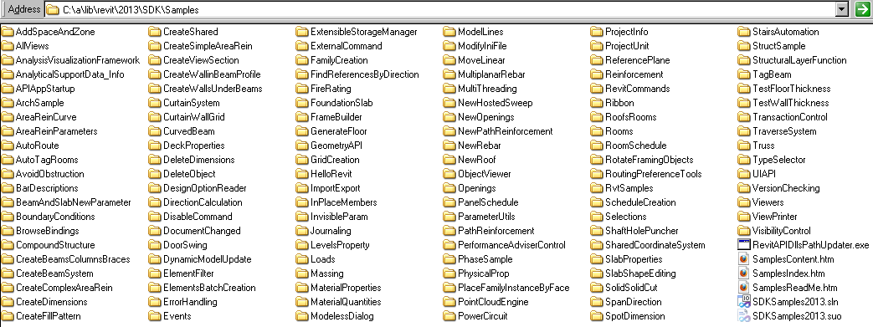
SDK Samples
Documentation
SamplesReadMe.htm
Utility
RevitAPIDllsPathUpdater.exe
Main samples solution
SDKSamples2013.sln
And the samples themselves!
Notes:
The Revit SDK samples provide a huge knowledge base on how to address specific programming tasks using the Revit API. The API documentation in the help file lists all the classes and their methods and properties, and the developer guide and samples explain and demonstrate how they work together to solve specific tasks.

Slide 7
Copy Revit API Assemblies
C:\Program Files\Autodesk\ > md "Revit MEP 2013"
C:\Program Files\Autodesk\ > md "Revit MEP 2013\Program"
C:\Program Files\Autodesk\ > copy
"Revit Architecture 2013\Program\RevitAPI.dll"
"Revit MEP 2013\Program"
C:\Program Files\Autodesk\ > copy
"Revit Architecture 2013\Program\RevitAPIUI.dll"
"Revit MEP 2013\Program"
Repeat for Structure as well...

Slide 8
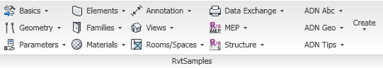
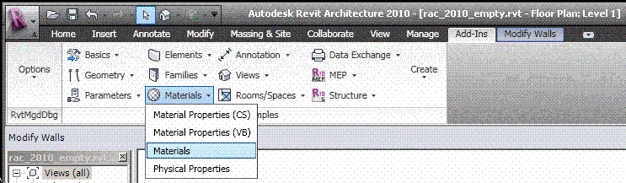
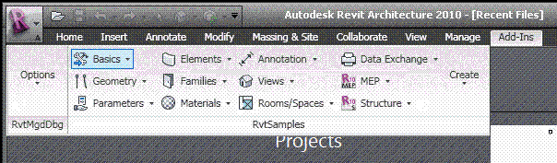
RvtSamples
So every external command needs an own manifest file?
Not using the SDK sample application RvtSamples!
Includes RvtSamples.txt listing all SDK samples
Adds them all to an own ribbon panel
Add one single add-in manifest file and never touch it again
You can add your own entries to RvtSamples.txt
Also define own pulldown buttons for additional sections
Example AdnSamples.txt
Notes:
The RvtSamples application and RvtSamples.txt is included in the Revit SDK ... show contents on screen in explorer ... so, SDKSamples2010.sln provides accesss to search and debug all sample source code, and RvtSamples enables running every single sample

Slide 9
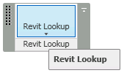
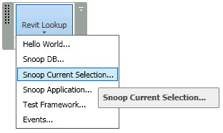
RevitLookup
Included in Revit SDK
Interactively access and explore entire database structure
Elements, parameters, relationships
Comprehensive Revit API test
Sample code and utility classes
Scaffolding for quick tests
Explore
Application
Document
Current selection
Reflection
Events
Tests
Notes:
RevitLookup, formerly RvtMgdDbg, is a utility similar to the well-known ArxDbg and MgdDbg utilities provided for AutoCAD, written by the same author and his team. It is a Revit extension application which defines its own ribbon panel.

Slide 10
Non-SDK Samples

Slide 11
Non-SDK Samples
RME Labs
Using the generic Revit API for RME: HVAC sample to calculate and resize ducts
Using the RME-specific API: electrical sample to generate a specialised tree view
RST Labs and Link
Revit Structure Labs and Link Sample, rst_lab.zip and rst_link.zip
MidasLink
Complete professional application
Handling elements, export and import forms
Localisation, Units
Installer
Available from ADN
Notes:
Before moving on to an overview and detailed discussion of the standard Revit SDK samples, let me point out a few interesting ones not included in the SDK. First and foremost, RvtMgdDbg is an absolute must-have for every serious Revit programmer. It is discussed in a separate session. We have implemented some specialised labs and samples for RME and RST which are discussed in separate sessions as well. Another more full-fledged RST linking sample is MidasLink, which is available on the ADN site.
Revit MEP 2009 provided the first MEP-specific API on the Revit platform. Before that, there were no RME-specific SDK samples. However, the generic Revit API can be used to access and modify an MEP model as well. For instance, the generic API can be used to implement an HVAC sample for calculating and resizing air terminals. The RME-specific API added in Revit 2009 makes it possible to implement more powerful applications making use of MEP-specific data. This is demonstrated by the Revit 2009 SDK samples AddSpaceAndZone, PowerCircuit, and RoofsRooms. We also implemented a non-SDK sample to analyse and display the connection hierarchy of an electrical system.
The important features of the structural API are the exposure of structural elements and their usage. Revit Structure manages a simplified analytical model for analysing the structural behaviour of the building under stress in parallel with the physical model which is of interest to architects and most other parties. In programming for Revit Structure, a developer often faces special requirements. The main areas of interest are linking the parallel analytical and physical models maintained by Revit Structure with an external analysis application, and optimising the generation of detailing drawings. A number of SDK samples are dedicated to the Revit Structure specific API and topics especially interesting in the structural domain.
Finally, an additional sample available for demonstrating the linking of an external analysis application with Revit Structure is provided by MidasLink. This sample is of special interest even to non-structural developers, because it constitutes a complete professional application and is in productive use. It demonstrates the element handling, export and import forms, localisation, unit handling, and also includes the complete source code for an installer.

Slide 12
Managing Samples
Resources, Utilities and Tools
Notes:
In this section, we look at overview documentation, utilities and tools for managing the wealth of existing Revit SDK samples effectively.

Slide 13
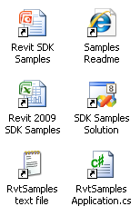
Managing Samples
Complete samples overview and readme
SamplesReadme.htm
Main samples solution
SDKSamples2013.sln
Knowledge base
Global search
Revit SDK samples spreadsheet
Revit_SDK_Samples.xlsx
External sample manager application
RvtSamples, a generic menu generator

Slide 14
SDK Samples Usage
Main tasks
Compile all projects
Load all projects into Revit
Search for solution to specific task
Main tools
Top-level search is supported by SamplesReadMe.htm
Compile and detailed search can be done in SDKSamples2013.sln
Load is handled by RvtSamples external application

Slide 15
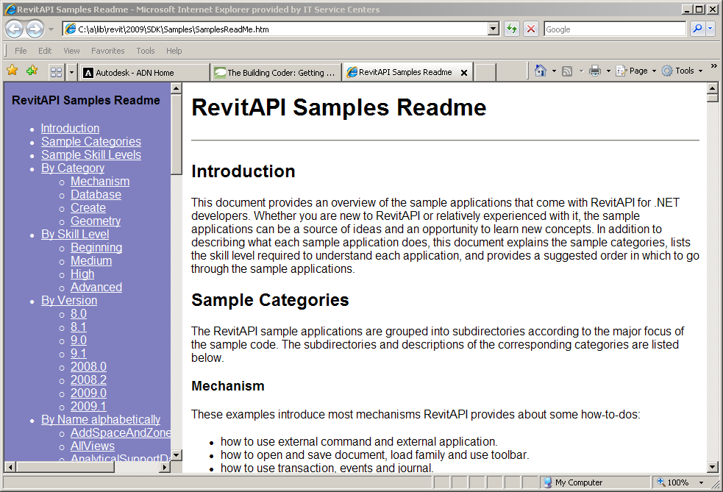
Complete overview and readme
Every sample in the Revit SDK includes a readme file
Mostly *.rtf, sometimes *.txt
This documentation is dispersed
Rtf files are hard to search globally
Enter SamplesReadme.htm
Modelled on ObjectARX samples readme
All descriptions in one file
Additional categorisations

Slide 16
Main Samples Solution
All Revit SDK samples are united in SDKSamples2012.sln
Both C# and VB
Compiling all samples requires correct reference path to Revit API assemblies
Installing Revit to default location matches default, otherwise adjust
Ensure 'Copy Local' flag is set to False
Use global searching to explore a specific programming task
Search for CreateWall
Whole word and match case
In Journaling, discover what we really want: NewWall()
Bare-bones external command requires add-in manifest
It is a large effort to test all samples one by one
Solution: RvtSamples external application
Notes:
Open SDK Samples solution; note that it contains both C# and VB projects. Search for CreateWall, note it appears many times, select whole word and match case, less hits, discover that the journaling sample actually calls the Revit API method NewWall, search for that, et voilà all samples that create walls. One remaining problem is that testing all the samples requires a lot effort in adjusting Revit.ini. In addition, it is impossible to add all the samples as individual external commands to Revit.ini at the same time, since that exceeds the maximum number of permitted menu entries.

Slide 17
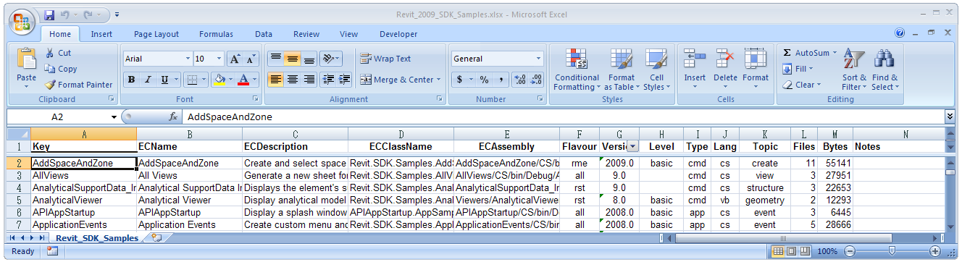
Revit Samples Spreadsheet
Excel spreadsheet listing all samples
Revit_SDK_Samples.xlsx
Includes the required add-in manifest data
Includes classification by various categories
Flavour: generic, rac, rst, rme
Version: 8.0, 8.1, 9.0, 9.1, 2008.0, 2008.2, 2009.0, 2009.1, 2010, 2011, 2012
Level: basic, intermediate, advanced
Type: cmd, app, exe
Language: cs or vb
Topic: creation, element, parameter, etc.
Files: number of source files
Bytes: total source file size
Notes:
Revit_SDK_Samples.xlsx is an Excel spreadsheet database of all the Revit SDK samples including all the EC or external command data required for creating the Revit.ini entries for invoking the samples as external Revit commands. It also manages additional information such as classification into different categories. This data is useful in itself to provide an overview of the samples. It can also be used to automatically generate Revit.ini entries to invoke the commands for test purposes. Last but not least, it is used to generate a text file RvtSamples.txt which is used as an input file by the RvtSamples external application to automatically generate a menu hierarchy including all SDK samples.
Open the spreadsheet, look at the classifications.

Slide 18
RvtSamples
External application
Defines entire menu hierarchy
Generic menu generator
Used for additional ADN and BC material as well
Lists all Revit samples
Multiple categorisations
Database driven
Avoid hitting max. number of menu entries
Minimal edits in Revit.ini
Enhanced version supporting #include
http://thebuildingcoder.typepad.com/blog/2008/11/loading-the-building-coder-samples.html
Notes:
RvtSamples is a generic Revit menu generator which reads a text file RvtSamples.txt listing all the Revit SDK samples categorised in various ways and creates a new top level hierarchical menu providing simultaneous access to all of them.
It is not limited to the SDK samples, you can add any other menu entry definitions you like, as well as or instead of the predefined ones for the SDK samples. For instance, in my system, I have added entries to define a second complete menu hierarchy for all the ADN, AU and The Building Coder samples.
RvtSamples is implemented as an external application and thus requires only a minimal edit of Revit.ini, an addition of two or maximally four lines, as opposed to the hundreds of lines required if you want to add the SDK samples individually. It defines its own menu hierarchy, which can be completely freely defined by the driving text file. Using the default database driven input file, it generates entries for all SDK samples, categorised in several different ways, e.g. by Revit flavour and original release version. It circumvents the maximum limit of about 50 entries that can be made to the Tools > External Tools submenu. Open the project, look at how to create menu entries, debug through steps in reading RvtSamples.txt and generating the menu hierarchy.
Open RvtSamples, look at how to create menu, debug through steps in reading RvtSamples.txt and generating menu and menu entries.
I have implemented an enhanced version of RvtSamples which supports an #include statement, similar to the functionality provided by the C and C++ language preprocessor. I use it to include my own regularly updated collection of samples. I have two collections of samples that I regularly work on and add to: the ADN and the Building Coder collections. To load them, I simply add the following two lines at the end of RvtSamples.txt:
#include C:/a/j/adn/train/revit/2009/src/AdnSamples.txt
#include C:/a/j/adn/train/revit/2009/src/bc/BcSamples.txt

Slide 19
SDK Samples Overview
Notes:
As already stated, the Revit SDK includes over one hundred different sample applications, demonstrating just about all of the functionality provided by the Revit API. This constitutes a huge knowledge base, and makes it important for every Revit developer to know how to manage and search the information provided. The samples are currently the main source of information on how to solve specific programming tasks in the Revit API. Whenever faced with a new Revit API issue, one of the first places to search for information is in the samples collection. Most tasks that can be accomplished through the API are illustrated by one of them. Obviously we will not be able to discuss each and every one of these in detail in this session. This section presents a chronological categorisation matching the development of the API itself, followed by some details on specific groups of samples.
The rest of the presentation provides a slightly more detailed first impression of selected samples. Since we cannot discuss every one, we will focus on some important basic samples useful for initial exploration of the Revit API features and suitable for beginners, and on the new samples added in the Revit 2009 time frame, which are of interest to developers who have already worked with the API and explored the ones that have been available for longer. The information we present is extracted from the global readme file provided in SamplesReadme.zip and in the individual sample documentation files Readme*.rtf.

Slide 20
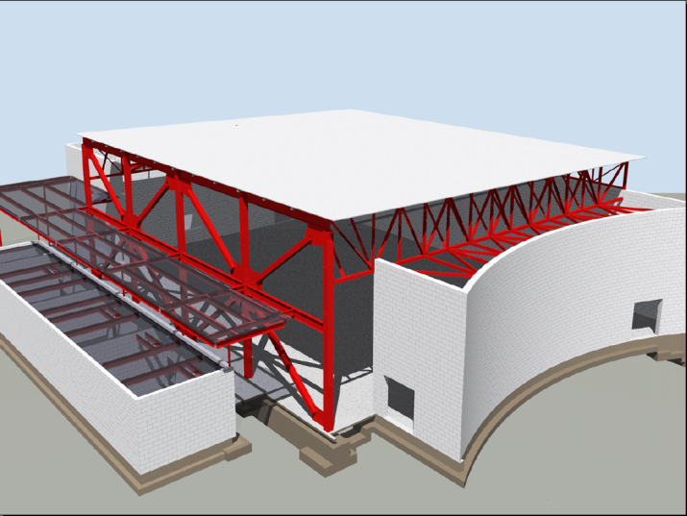
Basic Revit SDK Samples
ArchSample All
BrowseBindings All
CreateShared All
FireRating All
HelloRevit All
MoveLinear All
PhysicalProp All
RevitCommands All
StructSample All
TypeSelector All
ElementViewer All
RoomViewer All
AnalyticalViewer Rst
Notes:
These samples existed before Revit 9.0. Many of them were originally written using a COM API, which is no longer supported by Revit. They are all migrated to .NET now. With each sample, we also list the flavours of Revit it applies to, either Rac, Rme, Rst or All.
The samples listed above are often introductory in nature and provide a good starting point for initial exploration of the API. They are comparable to the Revit API Introduction labs, which constitute an alternative place to start such an exploration (cf. Learning More). The labs are more systematic than the basic samples, whereas the basic samples provide useful stand-alone functionality and more or less complete coverage. The basic samples often demonstrate access and analysis functionality, whereas creation of new element was added later and was a focus of the Revit 9.0 and 9.1 API releases. The following paragraphs highlight some of the important topics to explore when starting work with the Revit API. Remember that all the information presented here as well as a complete overview of all samples including a categorisation listing the basic samples is also available in SamplesReadMe.htm.

Slide 21
Revit 9.0 SDK Samples
AllViews All
AnalyticalSupportData_Info Rst
AreaReinCurve Rst
AreaReinParameters Rst
BarDescriptions Rst
BeamAndSlabNewParameter Rst
CreateBeamsColumnsBraces All
CreateComplexAreaRein Rst
CreateDimensions All
CreateSimpleAreaRein Rst
CreateViewSection Rst
CreateWallinBeamProfile Rst
CreateWallsUnderBeams Rst
DeleteDimensions All
DeleteObject All
DesignOptionReader All
GenerateFloor All
InPlaceMembers Rst
LevelsProperty All
Loads Rst
MaterialProperties All
ObjectViewer All
PhaseSample All
RotateFramingObjects All
SlabProperties Rst
StructuralLayerFunction Rst
VersionChecking All
Notes:
The sample categorisation into the different flavours of Revit is not always trivial. Some samples demonstrate features that work in all flavours of Revit, such as the creation of walls or section views, but rely on some flavour-specific detail for simplified calculation purposes, such as CreateViewSection and CreateWallsUnderBeams which make use of the RST analytical model.

Slide 22
Revit 9.1 SDK Samples
FrameBuilder All
Journaling All
ModelLines All
Openings All
ReferencePlane All
Rooms All
SharedCoordinateSystem All
BoundaryConditions Rst
CreateBeamSystem Rst
FoundationSlab Rst
Materials Rst
ObjectViewerII Rst
Reinforcement Rst
Notes:
Here is an overview of the Revit 9.1 SDK samples, sorted by Revit flavour and alphabetically. ModelLines and Materials were originally provided in two versions each, suffixed with 1 and 2. Later, in the 2008.2 update, these separate variations were united into one each. ObjectViewerII was removed in the 2008.2 SDK update, being very similar to ObjectViewer.

Slide 23
Revit 2008 SDK Samples
Described in
SDK/Samples/Revit 2008 New Samples.doc
APIAppStartup
ApplicationEvents
AutoTagRooms
BlendVertexConnectTable
CurvedBeam
FamilyExplorer
ImportExport
InplaceFamilyAnalyticalModel3D
NewOpenings
NewPathReinforcement
PathReinforcement
Added in 2008.2
RDBLink
RoomSchedule
ProjectInfo
ProjectUnit
ShaftHolePuncher
SpotDimension
TagBeam
TestFloorThickness
TestWallThickness
Toolbar
TransactionControl
ViewPrinter
VisibilityControl
Notes:
The samples added in Revit 2008 and in the Revit 2008.2 SDK update are described in a separate document in the Revit 2008 SDK, "Revit 2008 New Samples.doc".
ImportExport was originally named ImportExportDWG, and renamed in the 2009 timeframe when more formats were added.

Slide 24
Revit 2009 SDK Samples
All
CurtainSystem
ElementsBatchCreation
ElementsFilter
GridCreation
ImportExport
NewRoof
PlaceFamilyInstanceByFace
RvtSamples
SlabShapeEditing
RAC and RME (2009.1)
RoofsRooms
RAC
CurtainWallGrid
DoorSwing
NewHostedSweep
RME
AddSpaceAndZone
PowerCircuit
RST
NewRebar
Truss
Notes:
16 new samples were added to the initial release of the Revit 2009 SDK. One of these is RvtSamples, discussed above, which can be used to load all other samples into Revit.exe for testing and debugging. Another important 2009 sample that every developer should explore is ElementsFilter, because almost every application needs to make use of the new element filtering introduced in the Revit 2009 API. For the first time, we also have some RME-specific samples, as well as the RAC and RST ones. The RoofsRooms sample was added to the Revit SDK in the 2009.1 SDK update in the summer of 2008, matching the Revit 2009 web update 1.

Slide 25
Revit 2010 SDK Samples
Generic
RaytraceBounce
Ribbon
Revit MEP
AutoRoute
AvoidObstruction
TraverseSystem
Events
AutoStamp
AutoUpdate
CancelSave
EventsMonitor
PrintLog
FamilyCreation
AutoJoin
AutoParameter
CreateAirHandler (rme)
CreateTruss (rst)
DWGFamilyCreation
GenericModelCreation
TypeRegeneration
ValidateParameters
WindowWizard
Massing
DistanceToPanels
MeasurePanelArea
NewForm (5 commands)
PanelEdgeLengthAngle
Notes:
The 23 new samples reflect the main focus of the API development for Revit 2010: family API and conceptual design, ribbon, events, MEP. Events, FamilyCreation and Massing are separate subdirectories, the other samples are located in the main SDK Samples folder. To compile them all, you can use the main solution file. To load them into Revit, you can use the RvtSamples external application. We already discussed the ribbon and events samples. We will look at the family, form creation, and MEP ones in the later sections of the presentation. One sample that does not fall into any of these categories is RaytraceBounce, which demonstrates a new general-purpose model inspection method.

Slide 26
Revit 2011 SDK Samples
New
AnalysisVisualizationFramework
DistanceToSurfaces
SpatialFieldGradient
ConceptualDesign (* typo)
DividedSurfaceByIntersects
ElementFilter
ViewFilters
FindReferencesByDirection
FindColumns
MeasureHeight
Massing
ParameterValuesFromImage
PointCurveCreation
DirectionCalculation
DocumentChanged (ChangesMonitor)
DynamicModelUpdate
ErrorHandling
ExternalCommand
MaterialQuantities
PanelSchedule
Selections
SolidSolidCut
Modified
• HelloRevit
• ImportExport
• TransactionControl

Slide 27
Revit 2012 SDK Samples
CreateFillPattern
CompoundStructure
EnergyAnalysisModel
ExtensibleStorageManager
ExtensibleStorageManager
SchemaWrapper
PerformanceAdviserControl
PointCloudEngine
MultiplanarRebar
AnalysisVisualizationFramework
MultithreadedCalculation
SlaveSymbolGeometry
GeometryCreation_BooleanOperation
ProximityDetection_WallJoinControl

Slide 28
Revit 2013 SDK Samples
DisableCommand
ModelessForm_IdlingEvent ModelessForm_ExternalEvent
ModelessDialog
ProgressNotifier
Events
RoutingPreferenceTools
ScheduleCreation
StairsAutomation
UIAPI
WorkThread
MultiThreading

Slide 29
Revit 2014 SDK Samples
DisplacementElementAnimation
DockableDialogs
DuplicateViews
ExtensibleStorageUtility
FreeFormElement
PostCommandWorkflow
ScheduleAutomaticFormatter
ScheduleToHTML
SinePlotter
Site
Units
WinderStairs

Slide 30
Basic Revit SDK Samples
Notes:
The rest of the presentation provides a quick overview and a first impression of each sample. This information is extracted from the global readme file provided in SamplesReadme.zip and in the individual sample documentation files Readme*.rtf.

Slide 31
Basic Samples
Introductory
Pre-dating Revit 9.0
Good place to start looking at API
Comparable to Revit API Introduction labs
Labs are more systematic
Complete coverage
Not much for element creation
That became focus of later API releases

Slide 32
Interactive Element Selection
In 2008, explicit interactive element selection functionality was added
Current implicit selection set is passed to the command
Selection set can be changed from the command
If error returned, error set is highlighted
RevitCommands.Selection
ElementSet selSet = rvtApp.ActiveDocument.Selection.Elements;
Notes:
Before Revit 2008, explicit interactive element selection functionality was not available through the API. The pre-selected implicit selection set is passed in to the command. From 2008 onwards, the selection set can be changed from an external command. If an external command returns an error, the error set is highlighted and an optional message is displayed in the Revit user interface. This is demonstrated by the RevitCommands Selection sample, accessible by selecting an element and then executing Tools > External Tools > RevitCommands - Selection or RvtSamples > By Version > 8.0 > RevitCommands.Selection.

Slide 33
Object Properties
Generic properties provide access to
Type parameters
Instance parameters
Both include shared parameters (more later)
RevitCommands.ElementData
Dim instanceParams As Revit.ParameterSet = elem.Parameters
Dim typeParams As Revit.ParameterSet = elem.ObjectType.Parameters
Dim loc As Revit.Location = elem.Location
Dim geomElem As Revit.Geometry.Element = elem.Geometry
Notes:
The Revit API uses generic properties to provide access to type and instance parameters. Both may include shared parameters. One sample to begin exploring this topic is the RevitCommands ElementData sample.

Slide 34
Import and Export Data
Export to file or other applications such as Excel
Element and Type Properties
Location and Geometry
Samples
Simplest: ArchSample
Basic: FireRating, Revit Intro Labs 4
Advanced: RDBLink
Notes:
Exporting and importing data to or from a file or other applications such as Excel is a frequent requirement. Data such as element and type properties, location, and geometry may be exported and imported. The simplest sample demonstrating this is ArchSample, which exports to Excel. A more advanced but still basic sample is FireRating, which creates a new shared parameter for storing application specific data in the Revit model, exports it to Excel, and imports modified data from Excel back into and updates the Revit model. Finally, an advanced sample in this area is RDBLink.

Slide 35
Custom Data Addition
Use shared parameter mechanism
Add custom data, i.e. new parameters
Add to new and existing elements and types
Data can be hidden
FireRating (vb) and Lab 4-3 (cs + vb) commands
Apply Parameter
Export to Excel
Import from Excel
Revit.Parameters.Definition = ... ‘ e.g. Integer
Parameters.Binding = app.Create.NewInstanceBinding(categorySet) ‘ e.g. Doors
rvtApp.ActiveDocument.ParameterBindings.Insert(definition, binding)
Notes:
Application specific custom data, i.e. new parameters, can be added to the Revit model using the shared parameter mechanism. An application can add to new and existing elements and types. The data can be hidden from the user interface. The SDK samples FireRating in VB and the Revit API Introduction Lab 4-3 in both C# and VB demonstrate this by defining three commands:
Apply Parameter
Export to Excel
Import from Excel

Slide 36
Element Modification
Move and rotate elements
Swap element types programmatically
Groups
Generic property access
Move Linear command
Type Selector command
FireRating shows parameter editing
Notes:
Some basic requirements are to move and rotate elements, swap element types programmatically, manage groups of elements, and generic property access. This is demonstrated by the Move Linear and Type Selector commands, among others.

Slide 37
Load Families and Types
Load whole family
Load specific family symbol aka type
Search for families and types loaded in doc
RevitCommands Load Family and Load Family Symbol commands
rvtApp.ActiveDocument.LoadFamily(fileName)
rvtApp.ActiveDocument.LoadFamilySymbol(fileName, symbolName)
Notes:
Revit makes strong use of families and types. Loading a whole family and a specific family symbol or type as well as searching for already loaded families and types in the current document is demonstrated by the RevitCommands Load Family and Load Family Symbol commands.

Slide 38
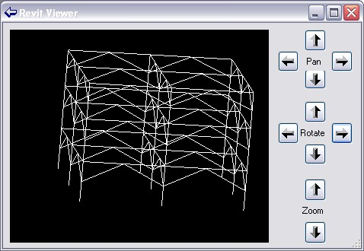
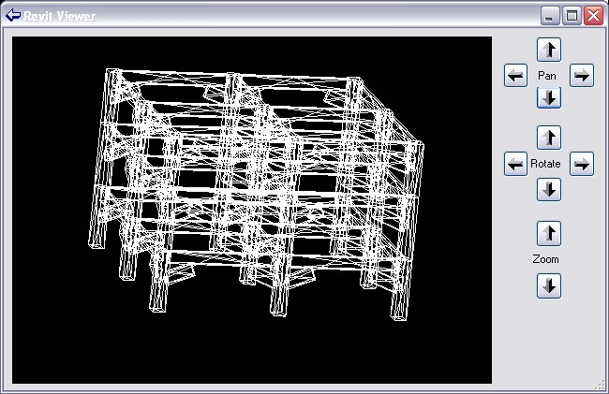
Viewers
AnalyticalViewer Rst
ElementViewer All
RoomViewer All
RevitViewer Utility
ObjectViewer All + Rst
Viewing elements
Analytical model
Physical model
Notes:
A good starting point for exploring the different types of geometry of Revit elements is provided by the geometry viewer samples. The Revit SDK currently includes the following viewers:
AnalyticalViewer
ElementViewer
RoomViewer
RevitViewer
ObjectViewer
All the viewers query a selected Revit element for some specific geometry, traverse it, break it down into simple line segments, and render those into a .NET System.Windows.Forms PictureBox. They can all be classified as pretty basic samples. The first four of these are all located in the subdirectory Viewers and are implemented in VB. They were introduced early on in the Revit API, with version 8.0. Of these four, the RevitViewer is a helper class, which implements the actual viewer window which is used by the other three to present three different views of certain subsets of the building model. ObjectViewer was introduced later, in the Revit 9.0 SDK, is written in C#, and defines its own rendering window. Below is an example of the form defined by RevitViewer; in this case, it is being driven by the ElementViewer sample and displaying the wall with a door and two little windows created by the external command defined by Lab2_0_CreateLittleHouse in the Revit API introduction labs. The form looks identical when driven by the AnalyticalViewer and RoomViewer samples, only the content displayed differs.
The AnalyticalViewer is for Revit Structure, to view the analytical building model. The analytical model is generally a simplified approximation of the building structure for structural analysis purposes, which is of most interest to the structural engineer. Revit Structure maintains the analytical model in parallel with the physical model, which is what architects and most other people are interested in.
ElementViewer is designed for all flavours of Revit and displays the standard element geometry.
RoomViewer is a viewer for displaying the two-dimensional outline of a room boundary.
Just like the three viewers, just discussed, ObjectViewer demonstrates viewing elements. It allows the user to select between the analytical and physical model, and also which view to display. You might thus say that it is a combination of the AnalyticalViewer and the ElementViewer with some additional features.
ObjectViewer includes both generic functionality usable in all Revit flavours, as well as some Revit Structure specific functionality. It displays a selected single element in a preview window and retrieves geometry from either the analytical or physical model. It also includes some additional useful odds and ends such as defining an own error message exception handling class and some unit handling functionality. ObjectViewer was originally introduced in Revit 9. Another very similar sample named ObjectViewerII was introduced in 9.1. ObjectViewerII was removed in the 2008.2 SDK update, being very similar to ObjectViewer.
For all of the viewers, the steps to run are similar: simply select the element whose geometry or the room whose boundary to display and start the external command. The analytical viewer will check whether any analytical model is available, which requires Revit Structure functionality. In the case of the ObjectViewer, all display views are listed, the detail level can be selected, and analytical and physical model can be switched.

Slide 39
Revit 9.0 SDK Samples

Slide 40

Revit 9 API Features
Significant API Features
Element Creation
Extended list of creatable elements
All family based elements
Wall, Floor, Level, Grid
Track Changes
Visually display changes performed by the 3rd party application
Let user accept or reject the changes
Notes:
So in terms new API features displayed there on your screen, it looks like there’s not a lot to see really, but as we all know the newly added to Element creation list is a massive inclusion. We can now create Walls, Floors, Levels, Grids and all Family Based Elements which means that the Revit API is now becoming a very powerful API indeed.
We also have the new Track Changes feature, which at the moment is only available in Revit structure. What it does is to track certain changes to elements across a single API external command, allowing the user to revert the changes back to what they were before a user ran your command. The way you revert a change is by Right-clicking the element you want to revert, and you should see the reversion options displayed there.

Slide 41
Revit 9 New Objects
Elements
AreaReinforcement
AreaReinforcementCurve
Dimension
LoadCaseArray/Iterator
LoadUsage
LoadUsageArray/Iterator
View
View3D
ViewDrafting
ViewSection
ViewSet/Iterator
ViewSheet
Symbols
AreaReinforcementType
DimensionType
Objects
ExternalCommandData
Geometry
BoundingBoxXYZ
ConicalFace
CylindricalFace
DoubleArray/Iterator
HermiteFace
PlanarFace
Reference
ReferenceArray/Iterator
RevolvedFace
RuledFace
Structural
AnalyticalSupportData
AnalyticalSupportInfo
AnalyticalSupportInfoArray/Iterator
BarDescription

Slide 42
New Creation Methods
AreaReinforcement
Dimension
Structural family instances
Floor
Grid
Level
LoadCase
LoadCombination
LoadNature
LoadUsage
View3D
ViewDrafting
ViewSection
ViewSheet
Wall
Notes:
LoadNature is used to define the type of load as Dead, Live, Seismic, Wind etc.
LoadUsage is used for visibility of loads only.

Slide 43
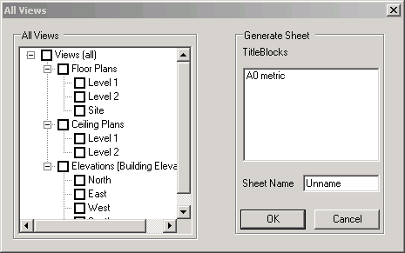
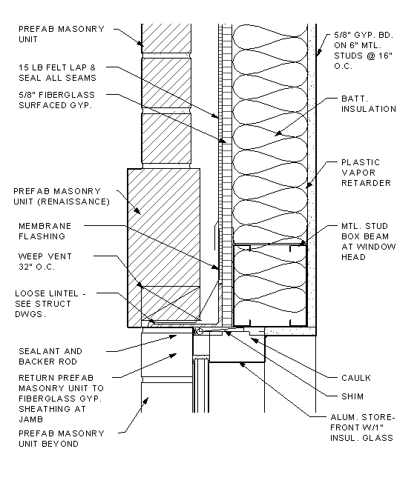
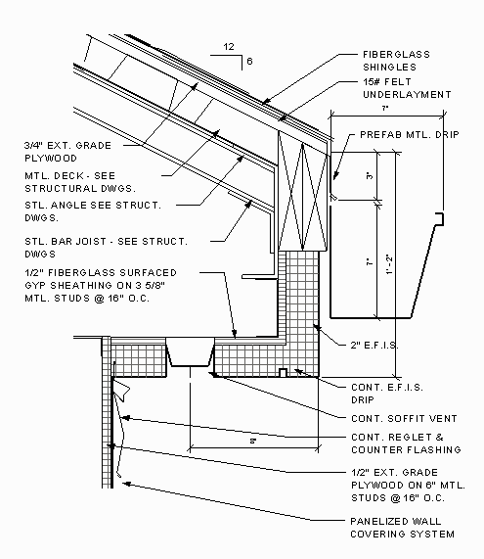
Sheets and Views
AllViews – All
Find all views in project and display in tree view
Create a new sheet with selected views
Demonstrate creating a ViewSheet via NewViewSheet()
Notes:
This sample finds all the views in a project and displays the names in a tree view hosted by the modal dialog that is displayed. The user can select several of the views and when OK is clicked a new sheet is generated that has all the selected views placed in it correctly sized, scaled and aligned.
When the command is executed a dialog appears that contains the following:
a) A tree view represents all the views’ names.
b) A list of all title blocks.
c) An edit box for the sheet’s name.
Note: All views should represent by category, not including schedules, sheets.
Loading the drawing Training\Metric\m_RST_SAVE DETAIL.rvt allows me to produce new sheets of all the elevations.
Extra Usage Notes:
draw a simple model.
check the current status of views and sheet. If there is no sheet, fine.
run the command.
choose views. Click ok.
check under Sheets. You can see a sheet where the selected views are placed.

Slide 44
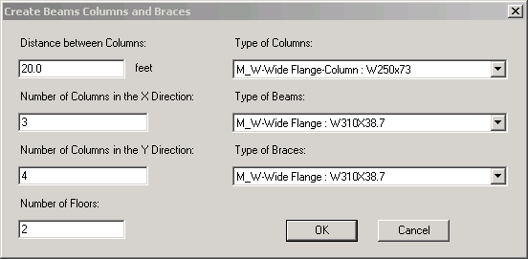
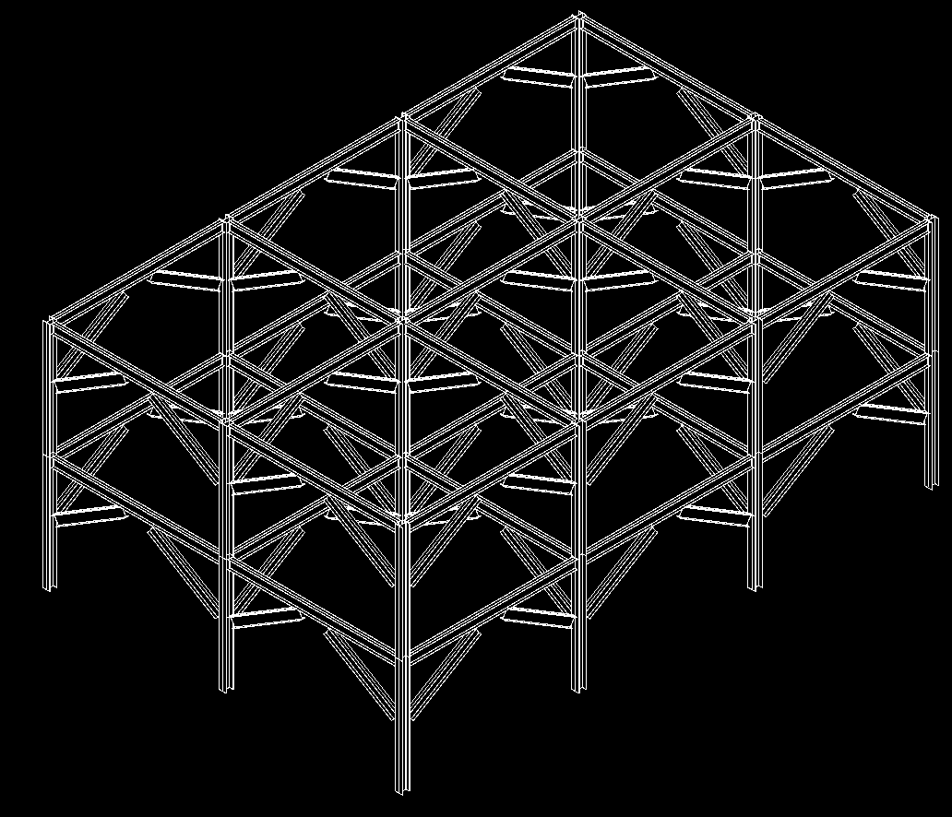
Beams, Columns and Braces
CreateBeamsColumnsBraces – All
Use NewFamilyInstance() to create structural elements
STRUCTURALTYPE stType = StructuralType.Beam;
// create the beam
FamilyInstance beam = doc.Create.NewFamilyInstance( ref pt, beamType, topLevel, stType );
// assign the location curve to the beam
LocationCurve beamCurve = beam.Location as LocationCurve;
if( null != beamCurve )
{
Line line = app.Create.NewLineBound( ref startPoint, ref endPoint );
beamCurve.Curve = line;
}
Notes:
This sample demonstrates the creation of new objects, in particular the NewFamilyInstance(). Notice that there’s some code below which shows how it’s done.
So lets take a look at the sample to see what it does exactly. Create a new project. Pick elevations to create 5 new levels, run the program.

Slide 45
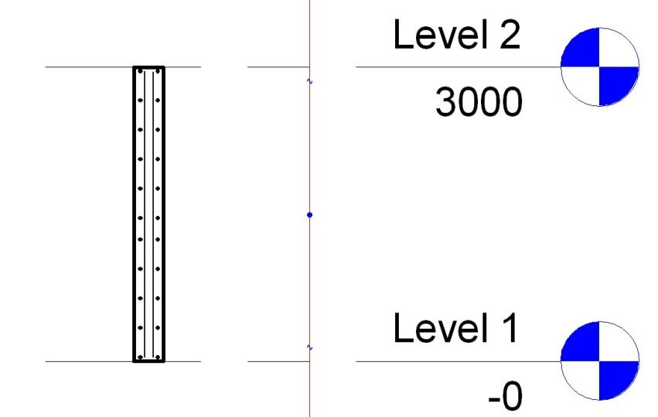
Area Reinforment
CreateSimpleAreaRein – Rst
Demonstrate creation of AreaReinforcement element
Uses NewAreaReinforcement()
Works on slab or wall
AreaReinforcementType symbol = dataOnWall.AreaReinType as AreaReinforcementType;
DocCreator creator = m_revit.Application.ActiveDocument.Create;
// create the area reinforcement
AreaReinforcement areaRein = creator.NewAreaReinforcement( symbol, wall, refer, curves );
Notes:
This sample creates an Area Reinforcement in a rectangular shape on a slab or wall.
Go to 3d view, then draw a wall/floor.
Select it, and execute the command. Accept default and ok. It will add a rebars to the wall/floor. (But it may not be visible.)
Move the cursor to the centre of the wall. You will see a "x" mark with "structural area reinforcement". This is what is added.
Goto Level1, then try creating a section. (View --> New --> Section). if you zoom in the section of a wall, you will see rebars placed inside of the wall.

Slide 46
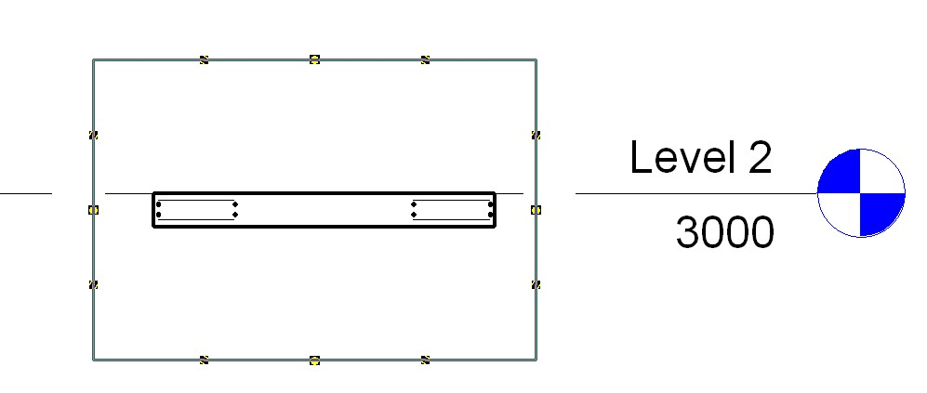
Area Reinforcement
CreateComplexAreaRein – Rst
Demonstrate creation of AreaReinforcement element
Uses NewAreaReinforcement()
Defines opening/cutout in slab
Only works on slab
Notes:
This sample is very similar CreateSimpleAreaRein, except that it generates a much more complex reinforcement detail and only works for a slab or floor.
The detail is created with all four layers of reinforcement defined and with two nested rectangular curve loops so that it defines a rectangular cutout opening.
On the interior 4 curves, set the override flag and flip the hooks on the top 2 layers to ‘up’, so the bars can hook into some walls around that opening.

Slide 47
Dimensions
CreateDimensions – All
DeleteDimensions – All
Demonstrate creation and deletion of a dimension
Uses NewDimension()
// create dimension line geometry
Line newLine2 = new Line( ref point1, ref point2, true );
// create the actual dimension
Dimension newDimension = doc.Create.NewDimension(
doc.ActiveView, newLine2, referenceArray );
Notes:
This sample requires a basic wall to be drawn and selected in order to function.
NOTE: If you are going to use this same inside Structural be aware that, by default, Basic Walls are NOT displayed unless you turn them on. Goto View properties -> Discipline, here it will be set to either Structural or Analytical (this excludes anything not having that model type property) – simply change it to "Architectural" .

Slide 48
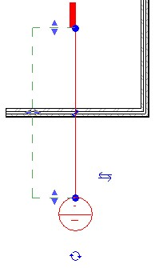
Section View
CreateViewSection – All
Demonstrate creation of a detail view
Uses NewViewSection()
Creates detail view across the midpoint of selected element
Works on linear element such as slab, wall or beam
// Create a section view:
ViewSection section = m_project.Create.NewViewSection( box );
Notes:
Next we have the CreateViewSection sample; this sample provides a tool for generating a section view across the mid point of a selected element. Draw a wall, beam or floor then select it to run the application.

Slide 49
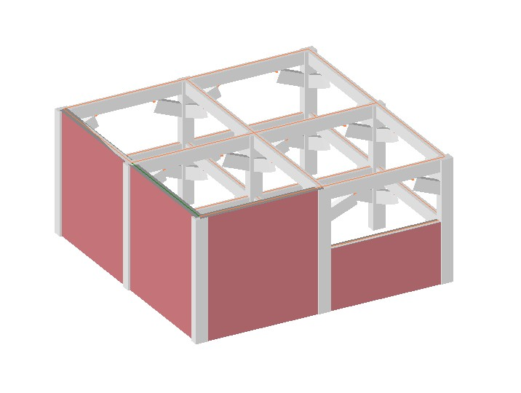
Walls
CreateWallsUnderBeams – All
Demonstrates creation of walls under selected beams
Uses NewWall()
Illustrates the AnalyticalModelFrame class
How to convert from physical model
Notes:
Create Beams Columns and Braces in Revit Structure. Select one or more of the beams and run the CreateWallsUnderBeams sample. This will create the walls, to show them, switch the shade mode to shaded.

Slide 50
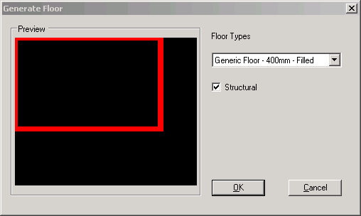
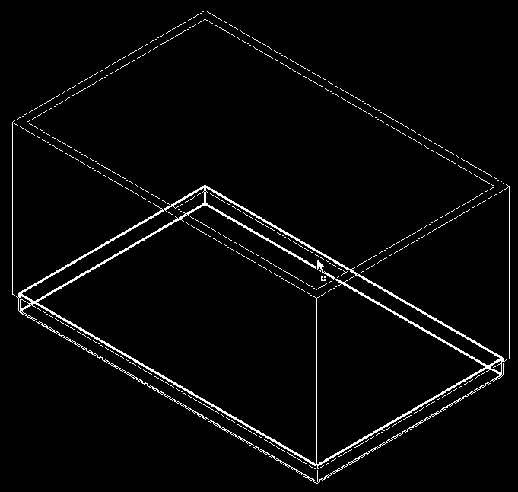
Floors
GenerateFloor – All
Demonstrates the creation of a floor or slab
Analyses wall geometry
Lists applicable floor types
Uses NewFloor()
// Create a new floor
Floor f = doc.Create.NewFloor( data.Profile,
data.FloorType, data.Level, data.Structural );
Notes:
This sample is very straight forward, you draw a closed room and run the command. You may get the Floor drawn on Level2 so set the properties of each of the walls so that the top constraint is level1 with a base offset of 0.0. Draw a wall, beam or floor then select it to run the application.

Slide 51
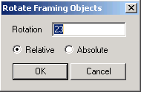
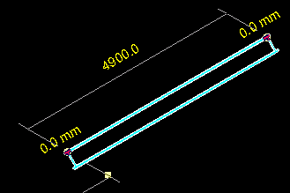
Rotation
RotateFramingObjects – All
Demonstrates how to rotate elements
Uses parameter access
// in case of a column
bool result = pointLocation.Rotate( rotateAxis, rotateDegree );
Notes:
This sample is a minimal sample which simply shows how to rotate objects selected from a Revit model via the API. It’s minimal, but answers a frequently asked question. Use Create Beams Columns and Braces to generate some test geometry, now you can run RotateFramingObjects nicely.

Slide 52
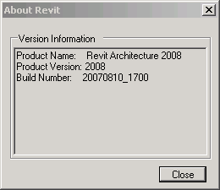
Product Version
VersionChecking - All
Demonstrates how to access the running product version
The most requested API feature!
Allows developers to channel functionality
Data is built into the Application class
Version name
Version number
Version build

Slide 53
Revit 9.1 SDK Samples

Slide 54
Revit 9.1 API Features
Access to journal file
Regression testing
Improved handling of units
Conversion between user interface and internal Revit database units
Ability to suspend updating
Model can be changed or updated through the API with minimal impact on speed
Significant performance improvements to element transformations
New Elements
ModelLine, Material, Opening, ReferencePlane, SketchPlane
Notes:
The information in this presentation has been extracted from the SDK document “Getting Started.doc” and from analysis of the Revit 9.1 SDK samples themselves.
Here are the new features common to both architecture and structure.
There are additional features specific to either one of the two as well. More new elements have been added for structure, we will see those in a moment.
Journal file:
The journal file records all input parameters obrtained from the user during a session. These can be used to rerun a similar session later on without any user interaction. This feature is useful for regression testing, both for Revit itself and for external programs. Therefore, external programs now have read and write access to the data in the Revit journal file.
Units:
DisplayUnitSystem = Is Revit set up to show units in metric or Imperial
DisplayUnitType = Returns the display units for a value
AsValueString = Returns the value properly formatted in the same way that Revit would format the text

Slide 55
Rac 9.1 API Features
Access to rooms
Find
Tag
Notes:
Access to rooms have been added which will provide the user with the ability to find rooms that have been defined by the user and number of tag them.
Rooms:
Autodesk.Revit.Elements.Room.Number
Autodesk.Revit.Elements.RoomTag
Autodesk.Revit.Creation.Document.NewRoom
Autodesk.Revit.Creation.Document.NewRoomTag

Slide 56
Rst 9.1 API Features
Define and access boundary conditions
New elements
Boundary Conditions
Beam systems
Path Reinforcement
Ability to define reinforcement bar sets

Slide 57
Revit 9.1 API Fixes
NewArc() added to API
Improved Span Direction API
Track changes no longer highlights type changes to the same type
Delete methods now return the ids of the elements deleted
Grid lines are now available immediately after creation
Significant performance improvements to element transformations through SuspendUpdating functionality
Notes:
Here is a list of some of the improvements made to existing functionality. Nothing really important if you have not happened to run into a problem with this in an earlier release.

Slide 58
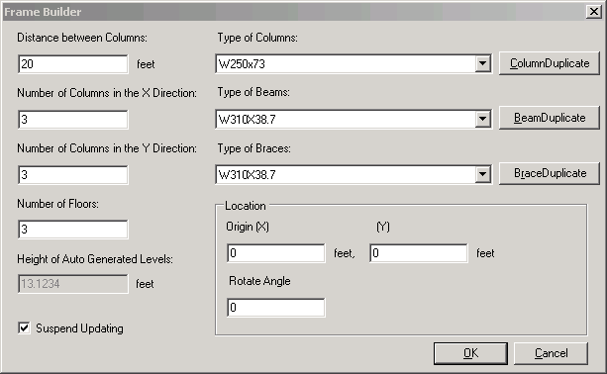
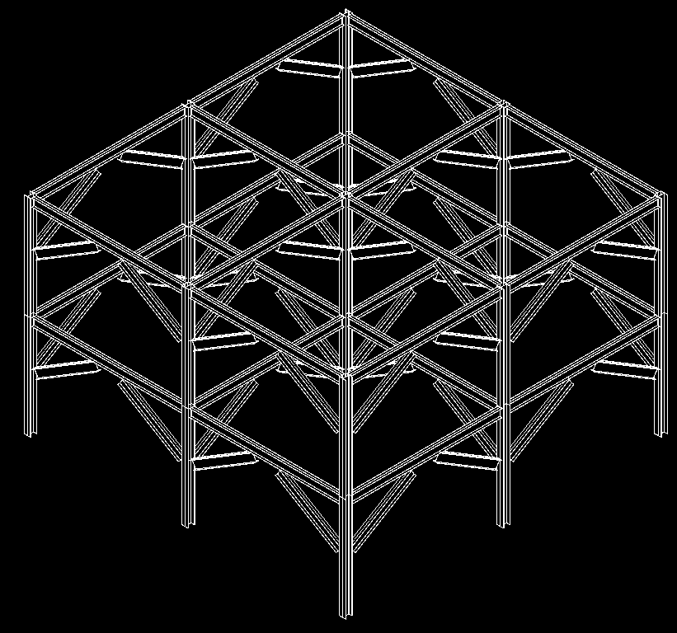
FrameBuilder
FrameBuilder – All
Composed of floors, levels, columns, beams, braces
Demonstrates methods
NewLevel(), NewFamilyInstance()
Illustrates the SuspendUpdating mechanism
New SuspendUpdating( doc ), SuspendUpdating.Dispose()
Notes:
This sample is very similar to CreateBeamsColumnsBraces sample. It is enhanced with SuspendUpdating. Also, it creates its own levels if some are missing.
SuspendUpdating mechanism is used to avoid display updating within an operation so as to improve performance. It’s usually used when many entities are created in a single command. Simply run the command in an empty or non-empty drawing, either in architecture or structure.
As far as I know, following is all the API operations SuspendUpdating covers currently:
1. apiRotate (4 overloads)
2. apiMove (4 overloads)
3. apiMirror (5 overloads)
For above transformation operations, SuspendUpdating can benefit performance much when operating on a single element many times in a loop.
But please notice: for batch operation — perform such operations on an ElementSet, because it calls regen only once, suspendupdating do not promote performance any more.
4. Leader
Revit::Leader::End::set
Revit::Leader::Elbow::set
5.FamilyInstance
Revit::Elements::FamilyInstance::StructuralUsage::set
Revit::Elements:: FamilyInstance::flipHand()
Revit::Elements::FamilyInstance:: flipFacing()
Revit::Elements:: FamilyInstance:: Rotate()
6.IndependentTag
Revit::Elements::IndependentTag::TagHeadPosition::set
Revit::Elements::IndependentTag::LeaderElbow::set
Revit::Elements::IndependentTag::LeaderEnd::set
7.TextNote
Revit::Elements::TextNote::Coord::set
Revit::Elements::TextNote::Width::set
8.Wall
Revit::Elements::Wall::WallType::set
Set some parameter may call regen. But parameter change is not covered by suspendupdating currently.

Slide 59
Journaling Mechanism
Journaling – All
All user actions in Revit are recorded in the journal file
C:\Program Files\Autodesk Revit Structure 4\Journals
To rerun journal file
Drag it onto Revit icon
Drag it onto open session
Pass it as command line parameter
Integrating an external application
Add and retrieve information to and from journal file
StringStringMap Autodesk.Revit.ExternalCommandData.Data
StringStringMap.Insert()
StringStringMap.Item()
Example application adds a wall and saves its data
VBScript-like, work around missing API issues
Notes:
This sample demonstrates the journaling mechanism, integrating an external application into the Revit journaling environment and adding and retrieving information to and from the Revit journal file.
Demonstrates NewLine(), NewWall(), StringStringMap.Insert() used by ExternalCommandData.Data property, the data map that can be used to read and write data to the Autodesk Revit journal file.
1. Run this sample in Revit for the first time. It will ask the user for some data to create a wall, and then record the data into the revit journal file.
Select any wall type, level 2, (0,0,0), (10,0,0).
The journal data is written to
C:\Program Files\Autodesk Revit Building 9.1\Journals\
2. Start Revit from the command line with the path to the journal file as a parameter, or drag and drop the file onto Revit. This sample reads the data in the journal file and recreates a same wall in Revit.
"C:\Program Files\Autodesk Revit Building 9.1\Program\Revit.exe" "C:\Program Files\Autodesk Revit Building 9.1\Journals\journal.0031.txt"
Case ID 1211118 [How to use the journal file]
Revit SPR #122247 some of Journal files in Structure Test Models won't re-play
C:\Program Files\Autodesk Revit Building 9.1\Journals\ >..\Program\Revit.exe journal.0036.txt
Regression Testing
Unknown to many, Autodesk Revit records the operations that the user performs into a text file known as a Journal file. These files can then be used to playback the same operations if Revit is started with the journal filename as part of the command line. If the results of the operations in Revit differ from those that were previously recorded the application will stop and note the failure in the resulting journal file. This process of creating a journal file and then playing it back to ensure that operations remain the same is known as Regression Testing and is quick and simple way of ensuring that you application does not differ from previous known to work versions.
User interface interaction during the external command are not recorded in the journal file so a mechanism has been provided to store a limited mount of data within the journal file when the command finishes so that that data can be passed to the external command when executed via the journal file. The commandData object that is passed to the external command now has a Data property that contains a String to String map to hold such data. If your application sets values in this map they will become stored in the journal file. If this data member contains data when your command is executed then your application should read this data and assume it is being operated from a journal file without user interaction and hence should not pause for any user input at any time thus ensuring that the command can be played back completely programmatically.
Note: currently there is a limitation on the amount of data that can be placed in the Data map.
How to use the Journal File for Regression Testing
All the user actions in a Revit session are recorded to a journal file.
The Journal file is usually located in the Journal folder of the Revit Installation. (Example C:\Program Files\Autodesk Revit Structure 4\Journals)
To rerun the journal file simply drag the file on top of the Revit icon on your desktop or into an open session of Revit.

Slide 60
Model Lines
ModelLines – All
Report the number of instances of each model line type
Create new model lines
Arc, Ellipse, Line, NurbSpline
New and Modified Classes and Methods
Autodesk.Revit.Elements.ModelCurveArray
Autodesk.Revit.Elements.ModelCurveArrayIterator
Autodesk.Revit.Elements.ModelCurve
Autodesk.Revit.Elements.ModelArc
Autodesk.Revit.Elements.ModelEllipse
Autodesk.Revit.Elements.ModelLine
Autodesk.Revit.Elements.ModelHermiteSpline
Autodesk.Revit.Elements.ModelNurbSpline
Autodesk.Revit.Creation.Document.NewModelCurve
Autodesk.Revit.Creation.Document.NewModelCurveArray
Autodesk.Revit.Creation.Application.NewArc
Notes:
In Revit 9.1, we have the possibility to create model lines and curves through the API. In order to create a model line, we have to create the underlying geometry line or curve first. For some of the complex curve types, there is no method available to create the geometry curve from scratch, so those types of model curves have to obtain their underlying geometry corve from some existing object.
The model curve types supported are arc, ellipse, line and hermite and nurb splines.
The hermite spline is required in order to import certain geometry from AutoCAD, it is normally not used by Revit itself.
The two samples are very similar. In ModelLines1, a new sketch plane is created for the new model lines, whereas in ModelLines2, the user may select an existing sketch plane.
Model Lines:
Autodesk.Revit.Elements.ModelCurveArray
Autodesk.Revit.Elements.ModelCurveArrayIterator
Autodesk.Revit.Elements.ModelCurve
Autodesk.Revit.Elements.ModelArc
Autodesk.Revit.Elements.ModelEllipse
Autodesk.Revit.Elements.ModelLine
Autodesk.Revit.Elements.ModelHermiteSpline
Autodesk.Revit.Elements.ModelNurbSpline
Autodesk.Revit.Creation.Document.NewModelCurve
Autodesk.Revit.Creation.Document.NewModelCurveArray
Autodesk.Revit.Creation.Application.NewArc

Slide 61
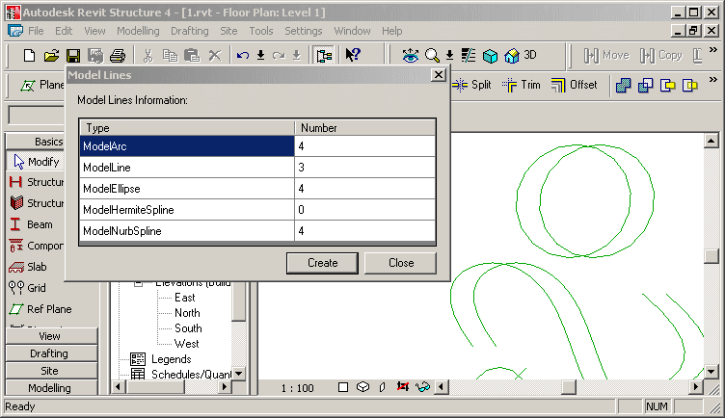
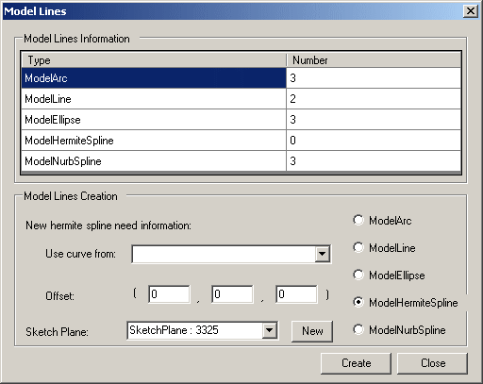
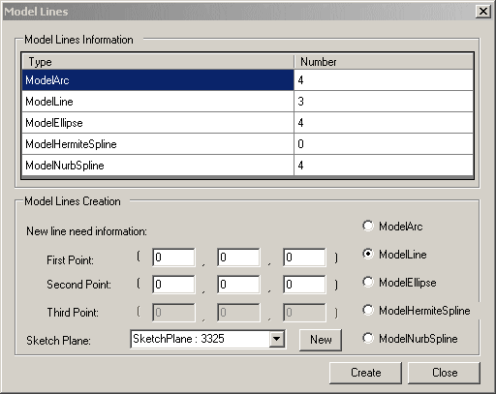
Model Lines
ModelLines – All
ModelLines1 - creates a new sketch plane for drawing the new model lines on
ModelLines2 - allows the user to select which existing sketch plane to draw the new lines on and data to use
You need to draw some ellipses and nurb splines before invoking the command. (these underlying geometry curves cannot be created with Revit API, yet.)
Notes:
Report the number of each model line type and allow the user to create one of each of the following in revit - Arc, Ellipse, Line, HermiteSpline and NurbSpline.
Makes use of Autodesk.Revit.Elements.ModelCurveArray.cs and an own helper class ModelCurveCounter.
Demonstrates the API calls NewSketchPlane(), NewArc(), NewLine(), NewModelCurve(), NewCurveArray(), NewModelCurveArray(),
Draw some ellipses, hermite and nurb splines before invoke the command, because the geometry curves of these cannot be created with Revit API.
Creates a new sketch plane for drawing the new model lines on.
ModelLines2 is similar to ModelLines1, but allows the user to select which existing sketch plane to draw the new lines on.

Slide 62
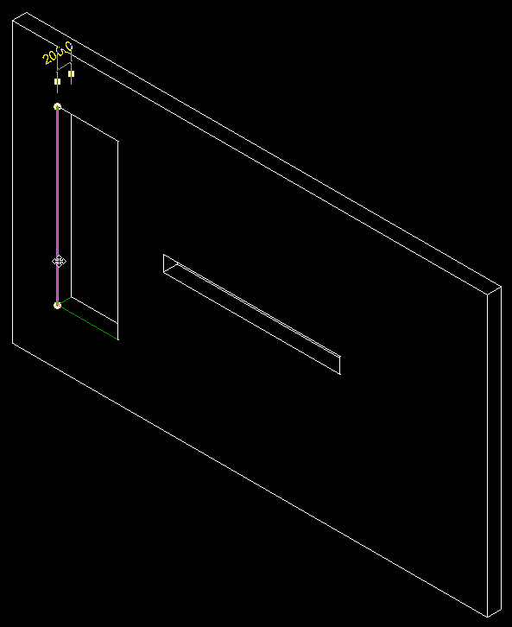
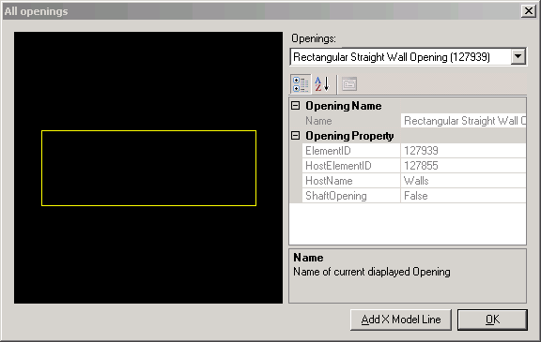
Openings
Openings – All
New API calls to access openings
Using family based elements or shafts
Sample displays openings and creates model lines on edges
Generic and Opening-specific helper classes
Vector, UCS, Line2D, Line3D, LineSketch, ObjectSketch
WireFrame to implement an own little mini graphics system
OpeningProperty, OpeningInfo
Notes:
Draw a wall, add one tall narrow and one low wide opening, run the command.
In the dialogue box, you can select any one of the openings in the model. It is displayed in a preview window. Clicking ‘Add X Model Line’ causes the application to draw model lines on the edges of the opening. For a rectangular opening in a planar wall, this will draw 12 model lines.
Bug: the model lines are in the wrong place if the wall is not axis aligned.
How to see the model lines created by this sample after running it? Use the tooltips on the 12 edges of the selected opening.
Description: Display openings in project and create X model lines on them.
Readme:
Autodesk Revit API application: Openings
This is a really minimal sample that shows how to get the property of an opening, show its profile in preview a window and create model lines on it. All the interesting code is in Openings project. Openings.cs contains the code to implement drawing. The WireFrame class retrieves the element profile.
To build the *.dll, edit project properties and make sure additional reference component include the Revit.dll in Revit Structure 4 installation directory. Then, paste the contents of Revit.ini into Revit.ini. Launch Revit, note the Tools -> External Tools -> Openings Commands menu.
This sample implements some generic helper classes Vector, UCS, Line2D, Line3D, LineSketch, ObjectSketch, WireFrame to implement an own little mini graphics system:
Vector: Point class use to store point coordinate value and get the value via (x, y ,z)property.
UCS: User coordinate system.
Line2D, Line3D: Line classes to represent a geometry segment line.
ObjectSketch: base class of sketch object to draw 2D geometry object, manages bounding box, pen and transformation.
LineSketch: sketch line and any tag on it.
WireFrame: class to generate the model lines and fit the picture box's size to display.
This sample implements some Opening-specific helper classes OpeningProperty, OpeningInfo
bug:
start revit
open 1.rvt
start openings
select one opening
select create x lines
close the dialogue
--> one opening is displayed on the revit screen with a black background
click View > Refresh
--> the whole screen turns black
it only happened once, when i was debugging a lot, and suspended the computer midway.

Slide 63
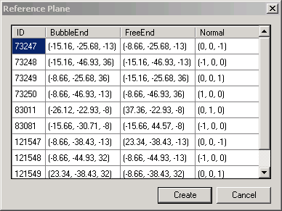
Reference Plane
Reference Plane – All
Report all reference planes in the current project
Show their ID, bubble end, free end, and normal
ReferencePlane class
Create a new reference plane at the left face of the selected wall or at the bottom of selected slab
NewReferencePlane() method
Notes:
I ran this in C:\a\j\adn\train\revit\mep\test\Urban House MEP.rvt.
Reference Planes and Sketch Planes
Autodesk.Revit.Creation.Application.NewPlane
Autodesk.Revit.Creation.Application.NewPlane
Autodesk.Revit.Creation.Document.NewReferencePlane
Autodesk.Revit.Creation.Document.NewReferencePlane2
Autodesk.Revit.Creation.Document.NewSketchPlane

Slide 64
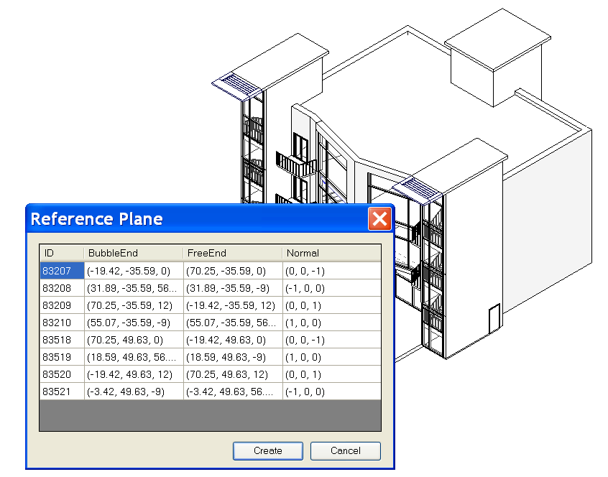
Reference Plane
Reference Plane – All
Notes:
Steps:
0. Open a .RVT file containing reference plane objects, e.g m_CoHouse.rvt in the training folder.
1. Run the external command.
2. A dialog will appear to report all reference planes in the current project, showing its ID, bubble end, free end, and normal.
3. If a wall or a slab is selected before the command is run, when Create button is clicked, a reference plan will be created at the left face of the wall or at the bottom of the slab.
4. After the new reference plan is created, we can list it out by running the command again.

Slide 65
Accessing Room Elements
Rooms – All
Report room information: ID, Name, Number, Level, Department, Area, Have tag
Room class
Create a tag for a room if it has none
NewRoomTag() method
Notes:
Rooms:
Autodesk.Revit.Elements.Room.Number
Autodesk.Revit.Elements.RoomTag
Autodesk.Revit.Creation.Document.NewRoom
Autodesk.Revit.Creation.Document.NewRoomTag

Slide 66
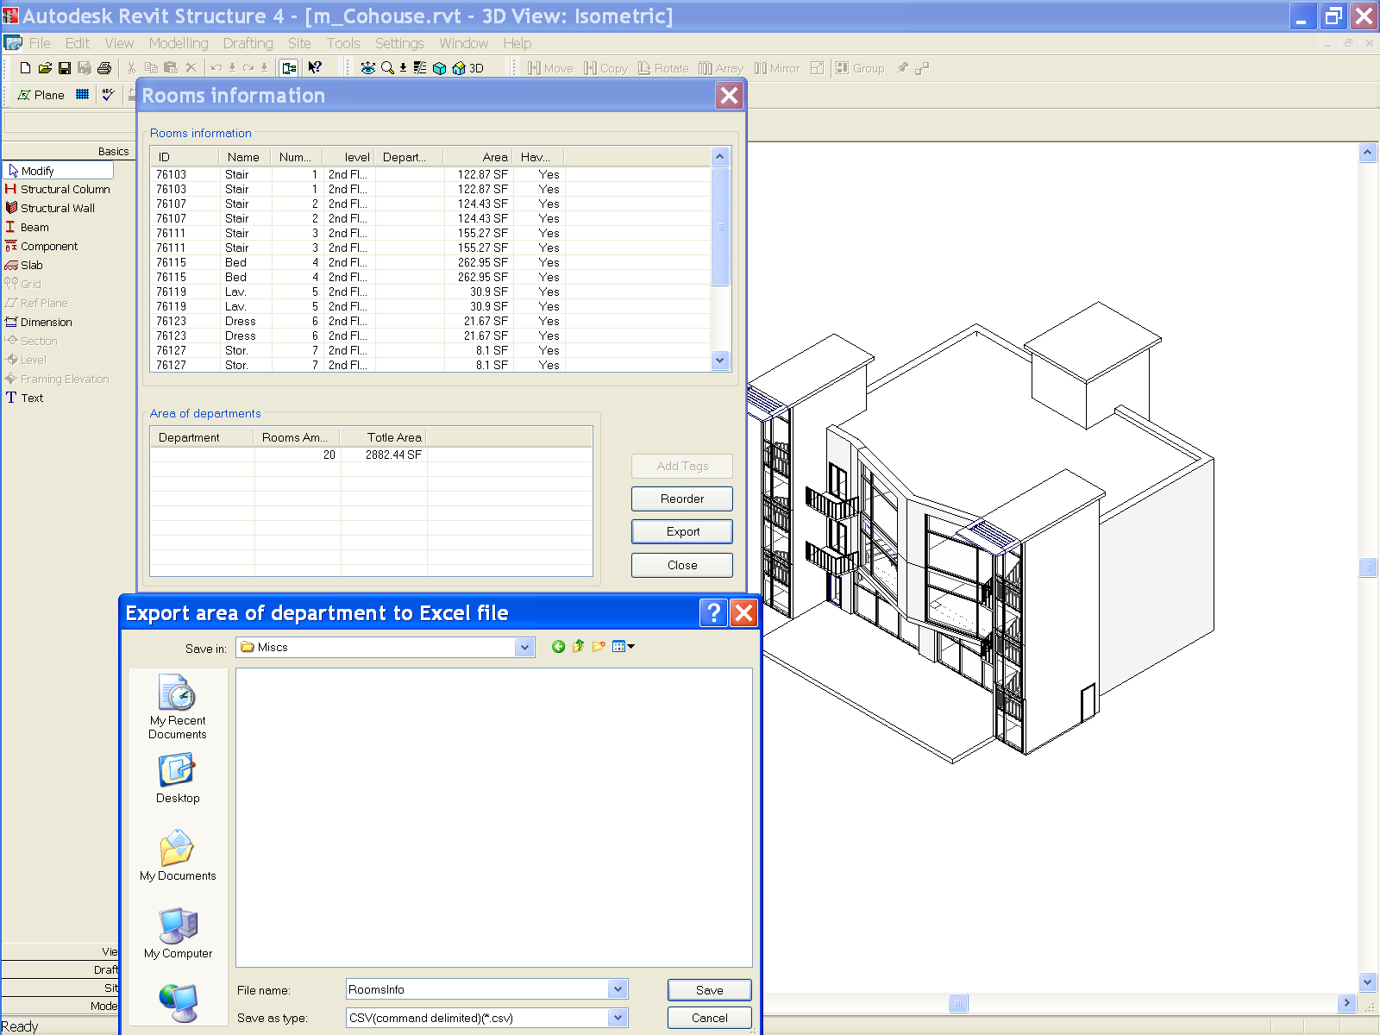
Accessing Room Elements
Rooms – All
Notes:
Steps:
0. Open a .RVT file containing room objects, e.g m_CoHouse.rvt in the training folder.
1. Run the command. A dialog will display the information of all rooms.
2. Create room tags and add them to the rooms which are lack of tags.
3. Reorder the number of all rooms by ascending order from ground floor to high floor, from left to right.
4. Calculate the rooms area for each department and export the result to an Excel document.
Why are there duplicates in the list above?

Slide 67
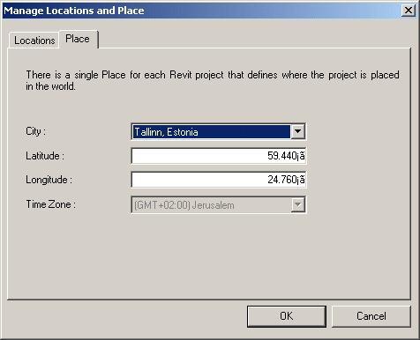
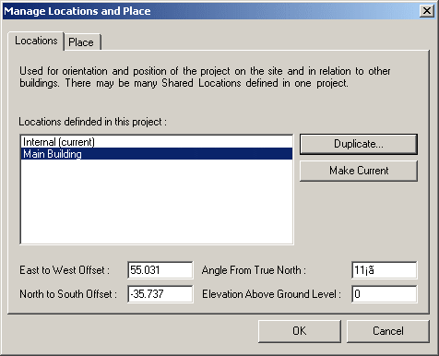
Location and Place
SharedCoordinateSystem – All
Display project location and site information
Similar to UI access, now API is available as well
[Settings] --> [Manage place and locations...]
Notes:
Display the locations and site information of the project.
1. Show the project location and site information for current project.
2. Users can set the values to change the location.
3. In the Project Browser, open a 2D plan view of the project. Click View menu and select View Properties, set the view orientation to True North.
4. On the Tools menu, click Shared Coordinates and select Acquire Coordinates.
To avoid the warning that timezone.txt could not be found, copy
R:\Samples\SharedCoordinateSystem\CS\timezone.txt
to
R:\Samples\SharedCoordinateSystem\CS\bin\Debug\timezone.txt
(1) where do you see this in UI.
This sample seems to be duplicating a two dialogs that you see in:
[Settings] menu --> [Sun and Shadows settings...] --> [Still] tab in [Name] --> click on the right-down arrow next to the [Place] under [By Date, Time and Place] toggle button,
You will see the very similar dialog there.
Actually, a better place to reach this info in UI is
[Setting] --> [Manage place and locations]
(2) what you see with External command?
If you duplicated the site location in the external command, you will see it there in the UI, too.
(3) implications
This is added for the Japanese developer who is developing Sun and Shadow Analysis. (Mikako logged this wish for GSA) In Japan, Sun and Shadow Analysis is the Must document. While revit has a long list of locations in ww, you couldn't have a more precise locations in earlier versions. (I think this is enhancement in UI, too. I don't remember exactly how it looked though...) So the developer can add more cities in Japan for exact locations.
The UI seems the same as 9.0, but there was no API to access this in the past.

Slide 68
Boundary Conditions
BoundaryConditions – Rst
Define and access boundary condition in the model
New and modified classes and methods
Autodesk.Revit.Elements.BoundaryConditions
Autodesk.Revit.Creation.Document.NewPointBoundaryConditions
Autodesk.Revit.Creation.Document.NewLineBoundaryConditions
Autodesk.Revit.Creation.Document.NewLineBoundaryConditions
Autodesk.Revit.Creation.Document.NewAreaBoundaryConditions
Autodesk.Revit.Creation.Document.NewAreaBoundaryConditions
Notes:
Now we come to the structure-only samples.

Slide 69
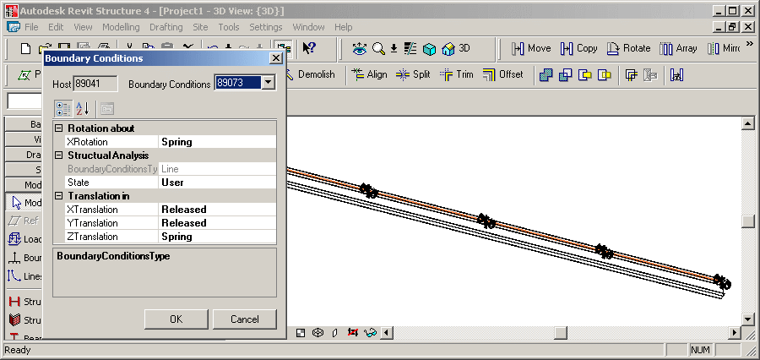
Boundary Conditions
BoundaryConditions – Rst
Display boundary conditions parameters
Create new boundary conditions
Notes:
Create a Structural Wall or Beam element.
Open a 3D view to see the analytical model, pointing out that no boundary conditions are set.
Select it.
Invoke the command.
Since it has no boundary conditions to start with, new ones are created and can be modified through the dialogue.
Set some boundary conditions.
Close the dialogue and point out that BCs have been added.
Autodesk Revit API application: BoundaryConditions
1. Firstly, user should select a structure element.
2. Invoke external command.
3. If the selected element has boundary conditions the parameters of the boundary conditions (BC) are presented. And users are also allowed to set these parameters with other valid values.
4. If the selected element does not have a BC then create one.
The sample set the conversion between the internal value and display value fit to Imperial unit.
Create a few walls in structural. Select one of them. Start the command.
The command checks whether exactly one element has been preselected and exits with an error message otherwise.
The method IsStructuralElement() determines whether the selected element is structural. To do so, it checks whether its class is one of FamilyInstance, Wall, Floor, or ContFooting, and whether it has a non-null AnalyticalModel property.
The boundary conditions for the selected element are collected from the database and saved in a dictionary in a BoundaryConditionsData instance, which also knows the host element, the dictionary key BC id.
If no boundary conditions have been set for the selected element, a suitable set of BCs are created when loading the form, in BoundaryConditionsForm_Load().
New boundary conditions are created by CreateBoundaryConditions(): point, line, and area.
Exercise the new API calls NewPointBoundaryConditions(), NewLineBoundaryConditions(), NewAreaBoundaryConditions().
The BoundaryConditionsData class has a member data object BCProperties which determines the data displayed by the ui PropertyGrid.
BCProperties knows about certain BC parameter values rules according to the Revit main program as well.
This sample also includes some sample boundary condition families: Boundary Conditions Fixed.rfa, Boundary Conditions Pinned.rfa, Boundary Conditions Roller.rfa, Boundary Conditions User.rfa
These families seems to be similar to the built-in boundary conditions?
This sample seems to be similar to the built-in boundary conditions command?

Slide 70
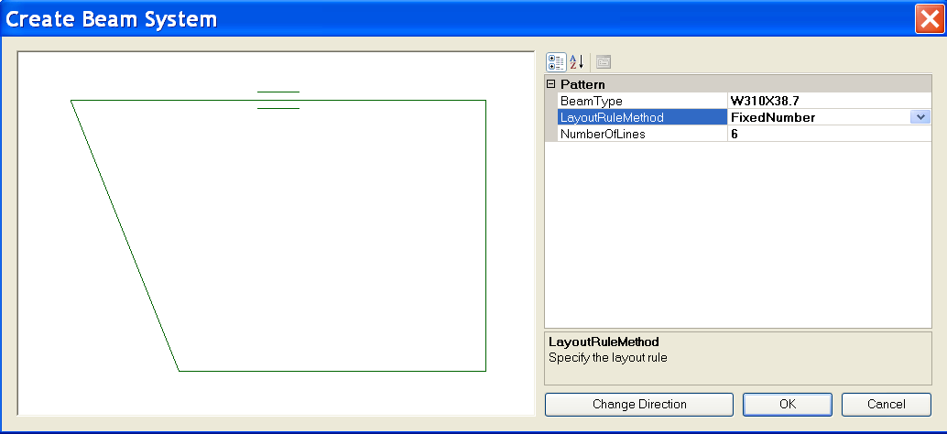
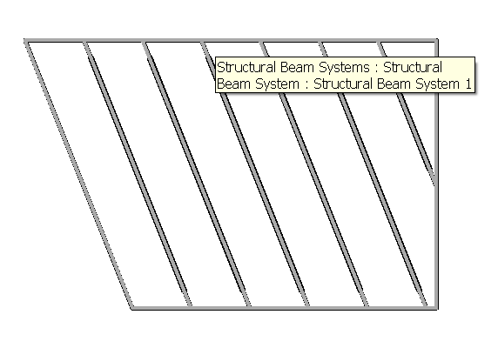
Create Beam System
CreateBeamSystem – Rst
Demonstrate creation of a beam system
Based on some connected framing beams
Uses NewBeamSystem()
Illustrates the BeamSystem class
How to convert from physical model
Notes:
Steps:
0. Create a few beams connecting to each other to form a loop.
1. Select all these beams before running the command.
2. Invoke the external command.
Choose layout method and beam type in the dialog.
Change the direction of the beam system if necessary.
Click OK button to create the beam system.
Note: The spacing of the beam system may not be easy to specify especially when you create the beams on the fly. You can choose FixedNumber LayoutRuleMethod in the Create Beam System dialog to make things easier.
Beam Systems:
Autodesk.Revit.Elements.BeamSystem
Autodesk.Revit.Elements.LayoutRule
Autodesk.Revit.Elements.LayoutRuleFixedDistance
Autodesk.Revit.Elements.LayoutRuleFixedNumber
Autodesk.Revit.Elements.LayoutRuleMaximumSpacing
Autodesk.Revit.Elements.LayoutRuleClearSpacing
Autodesk.Revit.Creation.Document.NewBeamSystem

Slide 71
Create Foundation Slab
FoundationSlab – Rst
Create octagonal foundation slabs for selected floors at the base of the building
Demonstrate Autodesk.Revit.Creation.Document.NewFloor()
Parameter BuiltInParameter.STRUCTURAL_FLOOR_ANALYZES_AS
'4' suggests foundation slab
Notes:
This sample requires a floor at the lowest level of the building.
In a new drawing, draw three structural walls forming a closed triangle. Draw a slab by walls on level 1, pick the three walls. Run the command.
(1) New drawing.
(2) Basics > Structural Wall > Click, Click, Click, Click.
(3) Double click Structural Plans > Level 1.
(4) Basics > Slab > Pick Walls > Click, Click, Click, Finish Sketch.
(5) Tools > External Tools > Foundation Slab.
This sample iterates over the current building model and assembles the following data:
// A set of levels to find out the lowest level of the building.
SortedList<double, Level> m_levelList = new SortedList<double,Level>();
// A set of views to find out the regular slab's bounding box.
List<View> m_viewList = new List<View>();
// A set of floors to find out all the regular slabs at the base of the building.
List<Floor> m_floorList = new List<Floor>();
// A set of regular slabs at the base of the building.
// This set supplies all the regular slabs' datas for UI.
List<RegularSlab> m_allBaseSlabList = new List<RegularSlab>();
// A set of the types of foundation slab.
// This set supplies all the types of foundation slab for UI.
List<FloorType> m_slabTypeList = new List<FloorType>();
It defines a helper class Sketch for drawing slabs and floors profiles into a WinForms PictureBox instance.
It calculates the bounding box of each floor, calculates an octagonal slab shape enclsing its bounding box.
On clicking OK, the original floor is replaced by an octagonal foundation slab.
Demonstrates the API call NewFloor().
Deletes the original floor.

Slide 72
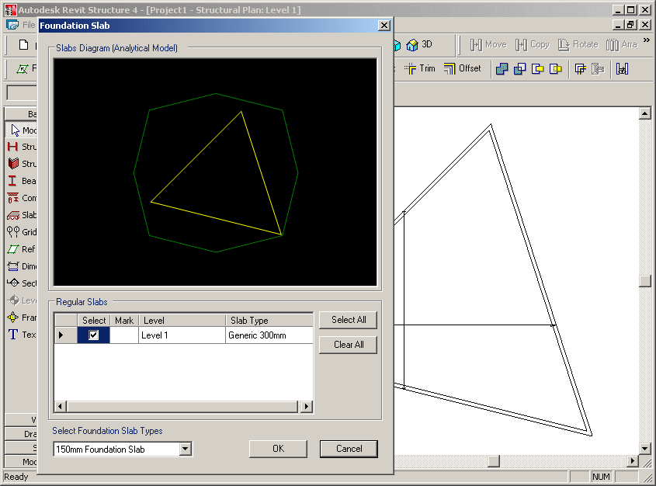
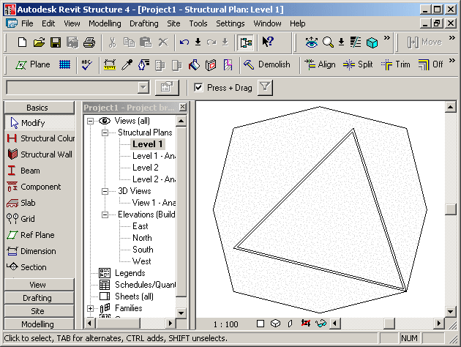
Foundation Slab
FoundationSlab – Rst
Extracts all floors and levels, determines lowest ones
Determines existing regular slab’s bounding box
Determines available foundation slab types
Implements a helper class Sketch for drawing slabs and floors profiles into a WinForms PictureBox instance
Calculates an enclosing octagonal slab shape

Slide 73
Structural Element Material
Materials – Rst
All available materials can be obtained by the property Materials of Setting object
All material parameters can be retreived using
Autodesk.Revit.Parameters.BuiltInParameter parameterId;
get_Parameter( parameterId );
One BuiltInParameter couples with one parameter
Structural Units are demonstrated as well
Materials2 is very similar to Materials1. No identity, misc. properties
Works with Structure – uses analytical model and “Beam Material”, “Column Material” properties
Currently, it won’t work with wall and floor: SPR #122487: Material API - doesn't reflect after changed
Notes:
Materials:
Autodesk.Revit.Color
Autodesk.Revit.FillPatternSet
Autodesk.Revit.FillPatternSetIterator
Autodesk.Revit.MaterialSet
Autodesk.Revit.MaterialSetIterator
Autodesk.Revit.Materials
Autodesk.Revit.Elements.FillPattern
Autodesk.Revit.Elements.Material
Autodesk.Revit.Elements.MaterialConcrete
Autodesk.Revit.Elements.MaterialGeneric
Autodesk.Revit.Elements.MaterialOther
Autodesk.Revit.Elements.MaterialSteel
Autodesk.Revit.Elements.MaterialWood
Autodesk.Revit.Settings.FillPatterns
Autodesk.Revit.Settings.Materials
Autodesk.Revit.Creation.Application.NewFillPatternSet
Autodesk.Revit.Creation.Application.NewColor
Autodesk.Revit.Creation.Document.NewMaterialSet

Slide 74
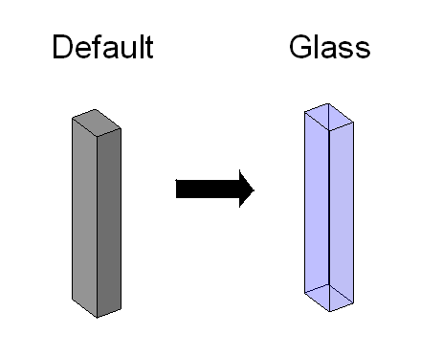
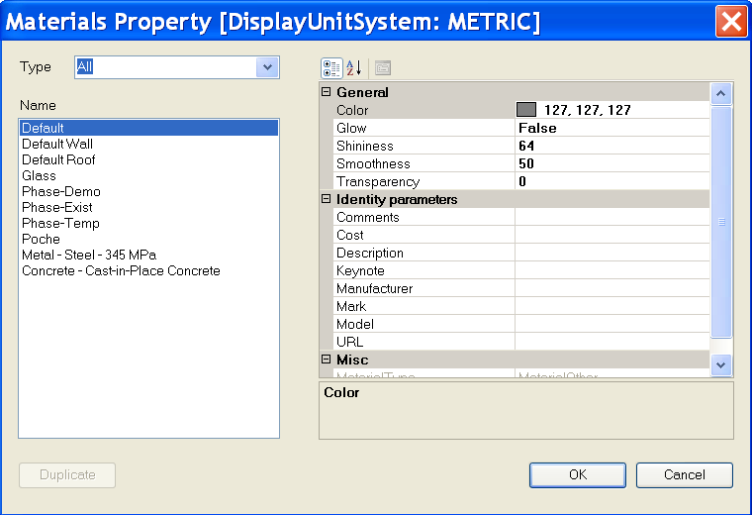
Structural Element Material
Materials – Rst
Notes:
Steps:
0. Create a structure element such as a column.
1. Select the structure element.
2. Run the external command.
3. All available materials in the current project will be listed out in a form.
4. Choose a material other than the previous one and press OK button.
5. The material of the structure element will be changed.
Note: Users can duplicate a concrete material which is not light weight.
Materials:
Autodesk.Revit.Color
Autodesk.Revit.FillPatternSet
Autodesk.Revit.FillPatternSetIterator
Autodesk.Revit.MaterialSet
Autodesk.Revit.MaterialSetIterator
Autodesk.Revit.Materials
Autodesk.Revit.Elements.FillPattern
Autodesk.Revit.Elements.Material
Autodesk.Revit.Elements.MaterialConcrete
Autodesk.Revit.Elements.MaterialGeneric
Autodesk.Revit.Elements.MaterialOther
Autodesk.Revit.Elements.MaterialSteel
Autodesk.Revit.Elements.MaterialWood
Autodesk.Revit.Settings.FillPatterns
Autodesk.Revit.Settings.Materials
Autodesk.Revit.Creation.Application.NewFillPatternSet
Autodesk.Revit.Creation.Application.NewColor
Autodesk.Revit.Creation.Document.NewMaterialSet

Slide 75
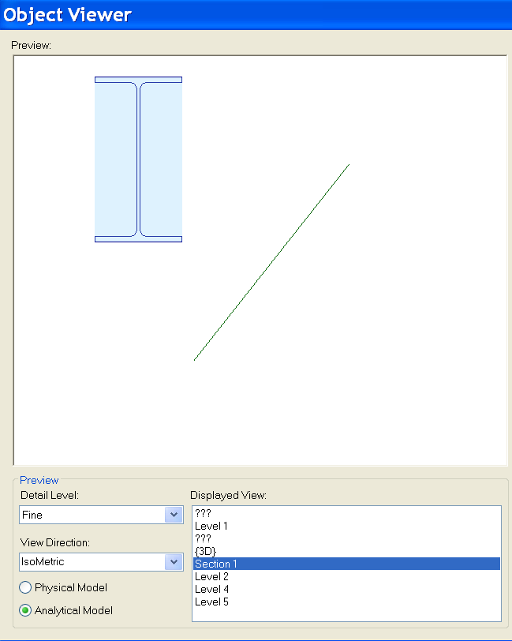
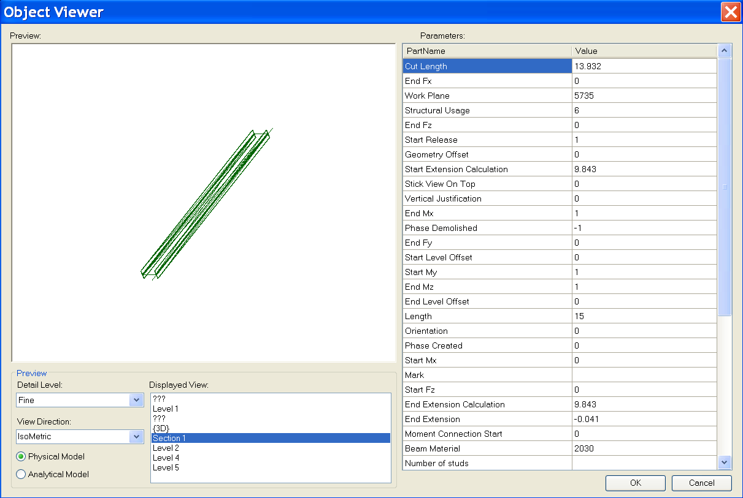
ObjectViewer
ObjectViewer – was ObjectViewerII – All + Rst-specific functionality
Display a selected single element in a preview window
Retrieve geometry from both physical and analytical model
Define an own error message exception handling class
Demonstrate unit handling
Notes:
Steps:
1. Select a structure element such as a beam.
2. Run the external command.
3. All Display Views are listed out. Detail Level can be chosen; Physical Model and Analytical Model can be switched.

Slide 76
Rebar in a Beam or Column
Reinforcement – Rst
Path reinforcement classes and methods
Autodesk.Revit.Elements.PathReinforcementCurve
Autodesk.Revit.Elements.PathReinforcement
Autodesk.Revit.Symbols.PathReinforcementType
Autodesk.Revit.Elements.SketchPlan
Autodesk.Revit.Elements.ReferencePlane
Autodesk.Revit.Elements.Opening
Autodesk.Revit.Geometry.Plane

Slide 77
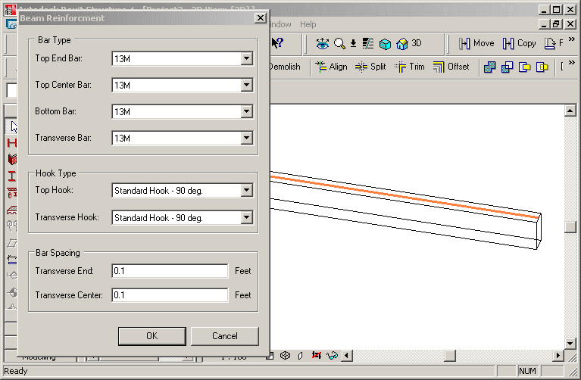
Rebar in a Beam or Column
Reinforcement – Rst
Create reinforcement rebars in selected non-reinforced concrete beam or column
Beam rebar: top, bottom or transverse
Column rebar: transverse or vertical
Notes:
Start Revit Structural, create a concrete beam, run the command.
Create reinforcement rebars on the selected concrete beam or column without reinforcement.
Create bar set in a selected concrete element (beam or column) that does not have any reinforcement.
1. Create bar set in a selected concrete element (beam or column) that does not have any reinforcement.
2. Beam rebar should be three kinds: top rebar, bottom rebar and transverse rebar.
3. Column rebar should be two kinds: transverse rebar and vertical rebar.
The class FrameReinMakerFactory does all the work, such as perform precondition testing
and create a corresponding FrameReinMaker and the reinforcement rebars.
Precondition checks include: is the selected object a beam or column, is it made of concrete, does it already contain any Rebar elements.
Two further classes do the work depending on host type: BeamFramReinMaker and ColumnFramReinMaker.
GeomUtil: basic geometric utility methods.
GeometrySupport: base class for BeamGeometrySupport and ColumnGeometrySupport, manages the solid of beam or column, the extend or sweep path of the beam or column, the director vector of beam or column, lists to store the edges and points, the transformation etc.
ParameterUtil: utility methods find or set certain parameter.

Slide 78
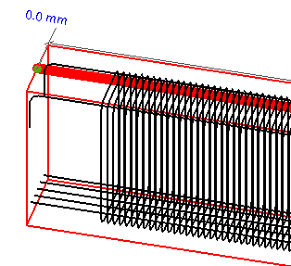
Rebar in a Beam or Column
Reinforcement – Rst
FrameReinMakerFactory class does all the work
Precondition checks
Is the selected object a beam or column?
Is it made of concrete?
Does it already contain any rebar elements?
Create a corresponding FrameReinMaker and the reinforcement rebars
Host-dependant working classes
BeamFramReinMaker and ColumnFramReinMaker
GeomUtil
Basic geometric utility methods
GeometrySupport
Base class for BeamGeometrySupport and ColumnGeometrySupport, manages the solid of beam or column, the extend or sweep path of the beam or column, the director vector of beam or column, lists to store the edges and points, the transformation etc.
ParameterUtil
Utility methods find or set certain parameter
Notes:
Start Revit Structural, create a concrete beam, run the command.
Create reinforcement rebars on the selected concrete beam or column without reinforcement.
Create bar set in a selected concrete element (beam or column) that does not have any reinforcement.
1. Create bar set in a selected concrete element (beam or column) that does not have any reinforcement.
2. Beam rebar should be three kinds: top rebar, bottom rebar and transverse rebar.
3. Column rebar should be two kinds: transverse rebar and vertical rebar.
The class FrameReinMakerFactory does all the work, such as perform precondition testing
and create a corresponding FrameReinMaker and the reinforcement rebars.
Precondition checks include: is the selected object a beam or column, is it made of concrete, does it already contain any Rebar elements.
Two further classes do the work depending on host type: BeamFramReinMaker and ColumnFramReinMaker.
GeomUtil: basic geometric utility methods.
GeometrySupport: base class for BeamGeometrySupport and ColumnGeometrySupport, manages the solid of beam or column, the extend or sweep path of the beam or column, the director vector of beam or column, lists to store the edges and points, the transformation etc.
ParameterUtil: utility methods find or set certain parameter.

Slide 79
Units
New and updated methods
Autodesk.Revit.Document.DisplayUnitSystem
Autodesk.Revit.Parameter.DisplayUnitType
Autodesk.Revit.Parameter.AsValueString
Notes:
Improved handling of units
Shelter the user from the internal Revit database units
DisplayUnitSystem = Is Revit set up to show units in metric or Imperial
DisplayUnitType = Returns the display units for a value
AsValueString = Returns the value properly formatted in the same way that Revit would format the text
Units:
Autodesk.Revit.Document.DisplayUnitSystem
Autodesk.Revit.Parameter.DisplayUnitType
Autodesk.Revit.Parameter.AsValueString

Slide 80
Revit 2008 SDK Samples

Slide 81
APIAppStartup
Demonstrates start up and shut down events (C#)
Interface IExternalApplication
public class AppSample : IExternalApplication
IExternalApplication.OnStartup() event
IExternalApplication.Result
IExternalApplication.OnStartup(ControlledApplication application)
{
String version = application.VersionName;
// display splash window for 10 seconds
SplashWindow.StartSplash();
SplashWindow.ShowVersion(version);
System.Threading.Thread.Sleep(10000);
SplashWindow.StopSplash();
return IExternalApplication.Result.Succeeded;
}
IExternalApplication.OnShutdown() event
IExternalApplication.Result
IExternalApplication.OnShutdown(ControlledApplication application)
{
MessageBox.Show("Quit External Application");
return IExternalApplication.Result.Succeeded;
}
Notes:
Note:
Please do not forget to use the latest version of the APIAppStartup sample. Its beta version is INCOMPLETE!
It works with both Architecture and Structure.
In the callback of the IExternalApplication.OnStartup() event, displays a splash screen.
In the callback of the IExternalApplication.OnShutdown() event, displays a dialog box.

Slide 82
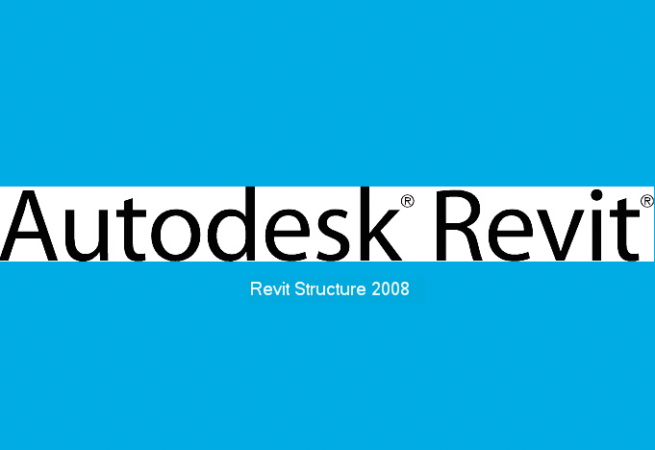

APIAppStartup Demo
Notes:
Steps:
1. Make sure the sample is registered as an external application. For example:
[ExternalApplications]
EACount=1
EAClassName1=APIAppStartup.AppSample
EAAssembly1=C:\Revit\SDK\Samples\APIAppStartup\bin\Debug\APIAppStartup.dll
2. Launch Revit 2008. Notice the splash screen will show up.
3. Quit Revit. Notice the dialog will show up.
4. Click OK to exit.

Slide 83


ApplicationEvents
Subscribe to application events and create custom menus (C#)
Modeless dialogue handling
Classes
Autodesk.Revit.Events.ApplicationEvents
Autodesk.Revit.MenuItem
Autodesk.Revit.Application
Autodesk.Revit.Document
Events
DocumentClosedEventHandler
DocumentOpenedEventHandler
DocumentSavedEventHandler
DocumentSavedAsEventHandler
Interface
public class RevitApplicationEvents : Autodesk.Revit.Events.ApplicationEvents
Event callbacks
public RevitApplicationEvents(Application app)
{
if (null != app)
{
app.OnDocumentClosed += new DocumentClosedEventHandler(OnDocumentClosed);
app.OnDocumentOpened += new DocumentOpenedEventHandler(OnDocumentOpened);
app.OnDocumentSaved += new DocumentSavedEventHandler(OnDocumentSaved);
app.OnDocumentSavedAs += new DocumentSavedAsEventHandler(OnDocumentSavedAs);
}
m_eventsLog = CreateEventsLogTable();
}
Notes:
The sample creates one custom top level menu and one sub-menu when Revit application starts up and uses this sub menu to show or hide a modeless window which displays the Revit application object events’ history log.
This sample will subscribe to Application’s document open, close, save and save as events.
This sample lists document’s opened, closed, saved or saved as information in a modeless window when the document is opened, closed, saved or saved as.
This sample creates a custom top level menu named "MyCustomTopMenu". And below this top menu a menu named "Track Revit Application Events" is created too to show and hide the modeless window.
Implementations:
The class which answers for adding custom menus must implement IExternalApplication interface. And the custom menus should be created in OnStartup method.
Application.CreateTopMenu method and MenuItem.Append method can be used to create custom menu.
OnDocumentOpened, OnDocumentClosed,OnDocumentSaved and OnDocumentSavedAs event handlers of Application class can be used to subscribe to relevant events.

Slide 84
Toolbar
Demonstrates how to create a toolbar (C# and VB.NET)
Derive from the IExternalApplication interface
class CreateToolbar : IExternalApplication
Implement the OnStartup method
public IExternalApplication.Result OnStartup( ControlledApplication application )
Create a toolbar
Application.NewToolbar()
Add a button
Toolbar.AddItem(MenuItem)
Toolbar commands are implemented with the interface
IExternalCommand
Notes:
This sample provides the following functionalities:
Add a custom toolbar with three buttons into Revit and Use Application.NewToolbar() to create the Toolbar via API.
Between the second button and the third button there is a separator.
Every button should have a corresponding command to execute. The command should implement the interface of IExternalCommand.
The first button will create a wall. Use Toolbar.AddItem(MenuItem) to add this button .
The second button will delete all walls in current project. Use Toolbar.AddItem(String, String) to add this button .
The third button will pop up a dialog box and show some information about Customer Toolbar.
There are two types of ToolbarItem, the third button has image only and the others two have both image and text.
Every button has a ToolTip when mouse on it.
Every button has a tip in Revit status bar to describe the button usage when it gets focus.
Implementation Notes
The command, which will be executed when the ToolbarItem button is clicked, should derive from IExternalCommand.
The Toolbar can be created via API: Application.NewToolbar().
The ToolbarItem button can be added via API: Toobar.AddItem(MenuItem) or Toobar.AddItem(String, String).
The separator is a ToolbarItem too, we can use AddItem(nullptr) to create this separator; or we can set the ToolbarItem’s ToolbarItemType property with ToolbarItemType::BtnSeparator.
The Image property of toolbar will affect the image of each ToolbarItem. Besides, the ImageIndex of toolbar will affect the image of ToolbarItem too.
ToolbarItem.ToolTip can set the tip when mouse move on the ToolbarItem button.
ToolbarItem.StatusbarTip can set the tip in Revit status bar when the ToolbarItem button gets focus

Slide 85

AutoTagRooms
C# Sample
Get all rooms in a specified level
Get all room tags in the current document
Create new room tags with specified type
Auto tag all rooms in a specified level
Classes
Autodesk.Revit.IExternalCommand
Autodesk.Revit.Elements.Room
Autodesk.Revit.Elements.RoomTag
Autodesk.Revit.Symbols.RoomTagType
Autodesk.Revit.Creation.Document
Code
RoomTag newTag = doc.Create.NewRoomTag( tmpRoom, ref point );
Notes:
This sample demonstrates three main features:
How to get all rooms in a specified level.
How to get all room tags in current document.
How to create new room tags with specified room tag type to auto tag all rooms in a specified level.
Add these lines to revit.ini file.
[ExternalCommands]
ECCount= 1
ECName1= Rooms Tag
ECClassName1= Revit.SDK.Samples.RoomsTag.CS.Command
ECAssembly1= RoomsTag.dll
ECDescription1= Auto tag all rooms in a specified level.
Steps:
Draw some rooms in different levels.
Run this command.
A dialog will be shown to display all the levels that have rooms, all the room tag types, all rooms in the selected level and the count of room tags of each type.
Select a level and a room tag type. Click the "Auto Tag All" to auto tag the rooms in the level.
Click "OK" button to accept the new created room tags or click "Cancel" button to abort them.

Slide 86

BlendVertexConnectTable
Retrieve all vertices and vertex connection edges of blend family (C#)
Classes
Autodesk.Revit.IExternalCommand
Autodesk.Revit.Elements.GenericForm
Autodesk.Revit.Elements.Blend
Autodesk.Revit.Elements.View
Autodesk.Revit.Elements.FamilyInstance
Autodesk.Revit.Geometry.Transform
Autodesk.Revit.Geometry.Curve
Autodesk.Revit.Geometry.XYZ
Notes:
This sample uses Autodesk.Revit.Elements.GenericForm, Blend and View classes mostly to get the blend family from selected solid blend mass, to retrieve the vertex connect edges and sketches of blend, to display the vertex connect information in form.
The blend object can be retrieved from FamilyInstance.Symbol.Family.SolidForms.
Top sketch and bottom sketch can be retrieved from Blend.TopSketch and Blend.BottomSketch properties.
Blend.FirstEnd and Blend.SencondEnd can be used to get Z coordinate values of bottom sketch and top sketch.
The Geometry.Element can be retrieved from Blend.get_Geometry(Geometry.Options).
GeometryObjectArray can be retrieved from Gometry.Element.Objects.
Geometry.Solid can be retrieved from Geometry.GeometryObject.
Geometry.Edge objects can be retrieved from Geometry.Solid.Edges.
To get projection matrix of current view, use properties RightDirection, UpDirection, ViewDirection of View and method Inverse of Transform.
Steps:
Register the command:
[ExternalCommands]
ECCount = 1
ECName1 = Blend Vertices and Vertex Connection Table
ECClassName1 = Revit.SDK.Samples.BlendVertexConnectTable.CS.Command
ECAssembly1 = C:\Revit\SDK\Samples\BlendVertexConnectTable\bin\Debug\BlendVertexConnectTable.dll
ECDescription1 = Get Blend Vertices and Vertex Connection Table.
Draw a solid blend form mass (Revit Structure 2008 User's Guide > Creating Your Own Components (Families) > Family Editor > Solid Geometry Tools > Creating Solid Blends).
Select the mass, and then run the command.
In the popped up form the PictureBox control paints the vertex connect edges of blend in blue color, paints all edges of sketch in black color, marks the top and bottom vertexes with "Tn" and "Bn" strings; the DataGridView control shows the vertex connect information.
User can reorder the DataGridView columns to see the connection information in different orders.

Slide 87


CurvedBeam
Create curved beams (C#)
Classes
Autodesk.Revit.IExternalCommand
Autodesk.Revit.Elements
Autodesk.Revit.Creation.Document
Autodesk.Revit.Symbols.FamilySymbol
Autodesk.Revit.Elements.FamilyInstance
Autodesk.Revit.Elements.Level
Autodesk.Revit.LocationCurve
Autodesk.Revit.Geometry.Arc
Autodesk.Revit.Geometry.Ellipse
Autodesk.Revit.Geometry.NurbSpline
Autodesk.Revit.Geometry.XYZ
Code
m_revit.Create.NewArc( ref center, radius, startAngle, endAngle, ref xAxis, ref yAxis );
m_revit.Create.NewEllipse( ref center, radX, radY, ref xVec, ref yVec, param0, param1 );
NurbSpline detailNurbSpline = m_revit.Create.NewNurbSpline( ctrPoints, weights, knots, 3, false, true );
beam = m_revit.ActiveDocument.Create.NewFamilyInstance( ref center, fsBeam, level, StructuralType.Beam ); // Beam according to curve
Notes:
This sample uses FamilySymbol, FamilyInstance, LocationCurve, Arc, Ellipse and NurbSpline classes mostly to get all structural framing types and levels from Revit project, create new beam and change the curve of new beam.
To get all structural framing types and levels of Revit, use ActiveDocument.Elements property.
To get all symbols of one family, use Family.Symbols property.
To get category of family symbols, use FamiySybol.Category property.
To create arc, ellipse and nurbspline, use NewArc, NewEllipse and NewNurbSpline methods of Autodesk.Revit. Creation.Document class respectively.
To create new beam instance, use NewFamilyInstance method of Autodesk.Revit.Creation.Document class.
To get location and curve of beam, use Location property of FamilyInstance class.
To change the curve of beam, use Curve property of LocationCurve class.
Steps
[ExternalCommands]
ECCount = 1
ECName1 = CurvedBeam
ECDescription1 = Create Curved Beam...
ECClassName1 = Revit.SDK.Samples.CurvedBeam.CS.Command
ECAssembly1 = CurvedBeam.dll
1) Build the *.dll, edit project properties and make sure additional reference component include the RevitAPI.dll in Revit installation directory.
2) Paste the contents of Revit.ini into Revit.ini. Launch Revit, execute the "Curved Beam..." command.
3) Select the type of beam, the level. Edit the position where you want to put the curved beam. Then click button "Arc", "Partial Ellipse" or "Nurbspline" to create corresponding type of beam.

Slide 88

FamilyExplorer
Display the profile (if applicable) of all families (C#)
Classes
Autodesk.Revit.Elements.Family
Autodesk.Revit.Elements.GenericForm
Autodesk.Revit.Geometry.Edge
Autodesk.Revit.Geometry.Transform
Notes:
Functionality:
List all families in the current document, including the in-place family.
Display the profile of the selected family with different colors, black for components, gray for others, green for solid forms, and yellow for void forms.
List all parameters of the selected family.
Implementation:
All families can be retrieved from method get_Elements(Type) of class Document, it provides access to all elements of specified type within the Document.
The family profile can be retrieved from the four properties of object Family:
Components, Others, SolidForms and VoidForms.
Components is an element set of all components that belong to a Family.
Others is an element set of all other components that belong to a Family.
SolidForms is a generic form set of all solid forms that belong to a Family.
VoidForms is s generic form set of all void forms that belong to a Family.
The geometry can be retrieved from the property Geometry of object Element or object GenericForm.
The components should be transformed according to UCS.
The viewer supports pan by click and drag and rotate by shift-click and drag.

Slide 89


Framing Builder
Create a frame composed of columns, beams and braces (C#)
private void NewBeam( UV point2D1, UV point2D2, Level baseLevel, Level topLevel )
{
// calculate the start point and end point
// of Beam's location line in 3D
double height = topLevel.Elevation;
XYZ startPoint = new XYZ( point2D1.U, point2D1.V, height );
XYZ endPoint = new XYZ( point2D2.U, point2D2.V, height );
// create Beam and set its location
FamilyInstance beam = m_docCreator.NewFamilyInstance(
ref startPoint, m_data.BeamSymbol, topLevel,
StructuralType.Beam );
SetLocationLine( beam, startPoint, endPoint );
}
Notes:
This sample creates a frame.
It presents a dialog to the user asking for the following information:
Distance between columns
Number of Columns in the X direction
Number of Columns in the Y direction
The type of the columns
The type of the beams
The type of the braces
Number of Floors
The codes should verify that the number of floors is not more than the number of levels since columns will be inserted from the level below to the level above. For example if the number of floors requested is 3, then there must be 4 levels and the columns will go from Level 1 to 2, Level 2 to 3 and Level 3 to 4. If there are not enough levels tell the user the number of levels that must be added and exit the command with a failure.
Starting with the lowest level and progressing to higher levels, insert columns with the specified type into the project programmatically in an array format based on the number of columns specified in the X and Y directions with the correct specified distance between them. Do this for each floor specified.
Insert beams of the specified type between the tops of each adjacent column in the X and Y direction to form a square grid of beams. Beams are not needed between diagonal columns.
Insert braces of the specified type between the mid point of each column and the mid point of each adjoining beam.
User can create a new concrete element type through duplicating specified type. The work flow is as follows:
Press the Duplicate button in the dialog;
Change name of column’s type and press OK;
Change value for b and h of section in another dialog and press OK;
Similar steps can be followed for concrete/wood beams and braces.

Slide 90




ImportExportDWG
Export the current project to DWG files
Import a DWG file into Revit (C#)
Methods
exported = doc.Export(folder, name, views, dwgExportOptions);
imported = doc.Import(m_importFileName, dwgImportOption, ref element);
Notes:
//parameter : DWGExportOptions dwgExportOptions
DWGExportOptions dwgExportOptions = new DWGExportOptions();
dwgExportOptions.ExportingAreas = m_exportOptionsData.ExportAreas;
dwgExportOptions.ExportOfSolids = m_exportOptionsData.ExportSolid;
dwgExportOptions.FileVersion = m_exportFileVersion;
dwgExportOptions.LayerMapping = m_exportOptionsData.ExportLayerMapping;
dwgExportOptions.LineScaling = m_exportOptionsData.ExportLineScaling;
dwgExportOptions.MergedViews = m_exportMergeFiles;
dwgExportOptions.PropOverrides = m_exportOptionsData.ExportLayersAndProperties;
dwgExportOptions.SharedCoords = m_exportOptionsData.ExportCoorSystem;
dwgExportOptions.TargetUnit = m_exportOptionsData.ExportUnit;
//parameter: DWGImportOptions
DWGImportOptions dwgImportOption = new DWGImportOptions();
dwgImportOption.ColorMode = m_importColorMode;
dwgImportOption.CustomScale = m_importCustomScale;
dwgImportOption.OrientToView = m_importOrientToView;
dwgImportOption.Placement = m_importPlacement;
dwgImportOption.ThisViewOnly = m_importThisViewOnly;
dwgImportOption.Unit = m_importUnit;
dwgImportOption.View = m_importView;
dwgImportOption.VisibleLayersOnly = m_importVisibleLayersOnly;
//parameter: Element
Element element = new Element();
In terms of the last parameter of the function Import, we don’t have to care much about it. And, we do not have to create a new element prior calling an Import method. We can simply pass a variable of Element type and it could be a nullptr. It is just a way if giving you back the element that was just imported. For example, say you import an image, since the import method does give you no scaling nor rotating option, if you happen to need such things you would have to do that manually after the image is imported.

Slide 91
InplaceFamilyAnalyticalModel3D
Display in-place family instance information
Instance name
Family name and type
Analytical model 3D curve
Notes:
Description:
Iterate through the selection, picking out family instances that have a 3D analytical model.
Output family instance information.
Family name (use FamilyInstance.Symbol.Family.Name).
Family Symbol name (use FamilyInstance.Symbol.Name).
Family Instance name (use FamilyInstance.Name)
Use FamilyInstance.AnalyticalModel property to access the analytical model and judge if the type is AnalyticalModel3D. And output the curve of this AnalyticalModel3D.
Instructions:
Create an in-place structure column that has AnalyticalModel.
Select some elements in which the in-place structure column is included.
Run this sample.
Expected result: the selected column’s basic information and the AnalyticalModel3D curves information will be dumped to output window.

Slide 92



NewOpenings
Demonstrates how to create openings (C#)
Classes
Autodesk.Revit.Creation.Application
Autodesk.Revit.Creation.Document
System.Drawing.Graphics
Autodesk.Revit.Elements.Wall
Autodesk.Revit.Elements.Floor
Code
// draw opening on wall with two points
Autodesk.Revit.Creation.Document doc;
doc.NewOpening( m_data, ref p1, ref p2 );
// create opening on floor according to curves
doc.NewOpening( m_data, curves, true );
Notes:
This sample uses Document.NewOpening method to create openings on the selected Wall or Floor. The profile can be created with NewCurveArray, NewArc and NewLine methods of Application.
Steps:
Register the command:
[ExternalCommands]
ECCount=1
ECName1=New Openings
ECClassName1=Revit.SDK.Samples.NewOpenings.CS.Command
ECAssembly1=NewOpenings.dll
ECDescription1=create openings on the selected floor or wall
Select a wall or a floor.
Run the command.
Draw the opening profile on the preview panel. Click the mouse middle button to switch tools, to draw a line, rectangle, arc or circle.
Click "Ok" button, openings will be created on the wall or floor.

Slide 93


NewPathReinforcement
Create PathReinforcement (C#, for Structure only)
Classes
Autodesk.Revit.Elements.PathReinforcement
Autodesk.Revit.Symbols.PathReinforcementType
Autodesk.Revit.Geometry.Face
Autodesk.Revit.Geometry.Edge
Autodesk.Revit.Geometry.Solid
Autodesk.Revit.Geometry.Element
Code
Options = Autodesk.Revit.Creation.Application.NewGeometryOptions();
Geometry.Element geoElem = elem.get_Geometry( options );
GeometryObjectArray geobs = geoElem.Objects;
PathReinforcementType pathReinforcementType = m_docCreator.NewPathReinforcementType();
m_docCreator.NewPathReinforcement( pathReinforcementType, host, CurveArray, bool );
Notes:
This sample demonstrates creating a PathReinforcement
1. Get geometrical data from FamilyInstance
Autodesk.Revit.Geometry.Element geoElem = Element.Geometry(Options);
GeometryObjectArray gObjects = Autodesk.Revit.Geometry.Element.Objects
2. How to create PathReinforcement.
NewPathReinforcement(PathReinforcementType, Element, CurveArray, bool) method:
Use Document.Create.NewPathReinforcementType() method to create one PathReinforcementType if there is no PathReinforcementType in current document.
Element here stands for the host of the PathReinforcement, a wall or a floor.
CurveArray stores the Path of the PathReinforcement.
bool value indicates the PathReinforcement lies to which side of Path.
[ExternalCommands]
ECCount = 1
ECName1 = NewPathReinforcement
ECClassName1 = Revit.SDK.Samples.NewPathReinforcement.CS.Command
ECAssembly1 = NewPathReinforcement.dll
ECDescription1 = Create PathReinforcement on wall or slab.
Steps:
Draw a Structure Wall or Slab and select it.
Run this command.
Draw the path of PathReinforcement you want to create, user can click right mouse button to finish drawing.
Click the "Preview" will preview the path reinforcement will be created.
Select or unselect "Flip" check box to create PathReinforcement on the left or right side of the path which you drawn.
Click "Create" button will create PathReinforcement when you finish the path.
User can clean and redraw the sketch of path when click "Clean" button.

Slide 94

PathReinforcement
Retrieve curves, profile and properties of path reinforcement object (C#)
Classes
Autodesk.Revit.IExternalCommand
Autodesk.Revit.Elements.PathReinforcement
Autodesk.Revit.Symbols.RebarBarType
Autodesk.Revit.Elements.ModelCurve
Notes:
This sample will get path reinforcement from active document and display its properties in a dialog. Curves of path reinforcement will be displayed in picture box and other data be displayed in property grid. The geometry data can be got by "Curves" property of path reinforcement and other properties can be got by "get_Parameter" and "Parameters" methods.

Slide 95

ProjectInfo
Demonstrate how to get and set the current project information (C#)
Classes
Autodesk.Revit.Document
Autodesk.Revit.Elements.ProjectInfo
Autodesk.Revit.Elements.gbXMLParamElem
Autodesk.Revit.Parameters.BuildInParameter
Autodesk.Revit.Parameters.BuildingType
Properties
Document.ProjectInformation
ProjectInfo.gbXMLSettings
Notes:
This program displays a form with all information of the current project information, including gbXml Settings, and allows the user to modify them.
1. Display the current project information including gbXml Settings.
2. Allow the user to modify all the information.
3. User can change the buildingType by choosing one from a list of available types.

Slide 96

ProjectUnit
C#
List project units and format information
Set decimal separator and slope type
Classes
Autodesk.Revit.IExternalCommand
Autodesk.Revit.Elements.ProjectUnit
Autodesk.Revit.FormatOptions
Notes:
Display the decimal symbol type of current project units and users can set it to comma or dot.
Display the slope type of current project units and users can set it to Rise or Angle.
List all the units in current project and display each unit’s format information.
List all the available Unit Discipline of current project in a list box
Classify the project units by the Unit Discipline
When users select one Unit Discipline in the list box to display the corresponding project units name (such as Length or Area) and its format information. The format information includes the display unit type (such as DUT_KIP_FEET_PER_DEGREE_PER_FOOT), the unit suffix type (such as UST_NONE), and the rounding (such as 0.2).

Slide 97
RDBLink
C#
Export and import Revit data to/from ODBC database
Modify or create Revit elements
Extensive documentation in ReadMe_RDBLink.rtf
Notes:
This sample demonstrates how to export Revit model data into ODBC database and how to import data from database into Revit to modify or create Revit models, getting and setting Revit parameter values. The sample takes advantage of DataSet, DataAdapter and CommandBuilder to implement database inserting, updating and deleting operations. There is only one external command. Import and export data function are triggered by clicking dialogue buttons.

Slide 98
RoomSchedule
C#
Retrieve spread sheet data
Create rooms without placing them
Update spreadsheet data with room data
Uses OleDb.OleDbConnection and OleDb.OleDbCommand to synchronize spreadsheet based room schedule with Revit rooms
Implements two commands: import room schedule from spreadsheet and update room area fields in spreadsheet by using data from Revit
Classes
Room, Level, Phase, Category, BuiltInParameter, Definition, DefinitionGroup, InstanceBinding, DocumentSaveEventHandler, DocumentSaveAsEventHandler, DocumentCloseEventHandler
System.Data.OleDb.OleDbConnection, OleDbCommand, DataTable
Notes:
This sample demonstrates how to retrieve spreadsheet data in excel, how to create rooms programmatically in Revit and how to update spreadsheet data with room properties. It also demonstrates how to create shared parameters, how to get all rooms in each PlanTopology and how to use the document event handler.
The sample uses OleDb.OleDbConnection, OleDb.OleDbCommand, DataTable and relevant Revit classes to synchronize spreadsheet based room schedule with Revit rooms. It implements two commands: import room schedule from spreadsheet and update room area fields in spreadsheet.

Slide 99


ShaftHolePuncher
Create shaft opening on a wall, floor or beam
NewOpening()

Slide 100

SpotDimension
Retrieve all spot dimensions and properties in all views (C#)
Classes
Autodesk.Revit.IExternalCommand
Autodesk.Revit.Elements.SpotDimension
Autodesk.Revit.Parameter
while (elementIterator.MoveNext())
{
object obj = elementIterator.Current;
//find all the SpotDimensions and views
SpotDimension tmpSpotDimension = obj as SpotDimension;
if (null != tmpSpotDimension)
{
m_spotDimensions.Add(tmpSpotDimension);
if (m_views.Contains(tmpSpotDimension.View.ViewName) == false)
{
m_views.Add(tmpSpotDimension.View.ViewName);
}
}
}
Notes:
Steps:
Register the command:
[ExternalCommands]
ECCount=1
ECName1=SpotDimension
ECClassName1 = Revit.SDK.Samples.SpotDimension.CS.Command
ECAssembly1 = C:\Revit\SDK\Samples\SpotDimension\CS\bin\Debug\SpotDimension.dll
ECDescription1 = Get all the spot dimensions in the all views and show each spot dimension's properties.
First draw an element (for example a wall), and then draw some spot dimensions with Revit Menu Command: Drafting->Spot Dimension tool in Revit UI.
Load and run the SpotDimension.dll.
Select a view to show all the spot dimensions in that selected view. And then select a spot dimension to show its properties in a DataGridView at the bottom of the dialog.
Select a spot dimension, and then close the dialog to return Revit, then the spot dimension will be highlighted afterwards.

Slide 101



TagBeam
Create tags at the start and end of selected beams (C#)
Classes
Autodesk.Revit.IExternalCommand
Autodesk.Revit.Elements.FamilyInstance
Autodesk.Revit.LocationCurve
Autodesk.Revit.Elements.Family
Autodesk.Revit.Symbols.FamilySymbol
Autodesk.Revit.Creation.Document
Autodesk.Revit.Elements.IndependentTag
Methods
FamilyInstance.Location.Curve.EndPoint()
IndependentTag tag = docCreator.NewTag(
m_view, beam, leader, tagMode,
tagOrientation, curve.get_EndPoint(0) );
Notes:
This sample demonstrates how to create tags at the start and end of selected beams.
Tags’ Properties of leader 、TagMode、TagOrientation can be changed through the dialog.
The selected beam object is retrieved from Document.Selection.
The available Family belonging to the three tag mode--tag by Category, Multi-Category Tag and Material tag is retrieved from Document.Elements by judging familySymbol’s category.
The start point and the end point can be retrieved from FamilyInstance.Location.Curve.EndPoint[] property.
Use Autodesk.Revit.Creation.Document.NewTag(View, Element, Boolean, TagMode, TagOrientation, XYZ) method to create tag.
[ExternalCommands]
ECCount = 1
ECName1 = TagBeam
ECClassName1 = Revit.SDK.Samples.TagBeam.CS.Command
ECAssembly1 = TagBeam.dll
ECDescription1 = "Tag beam's start and end."
Steps:
1. Draw some beams and select them.
2. Run this command.
3. Select tag mode--tag by Category, Multi-Category Tag or Material tag, and then select the tag family symbol of this mode. Select the tag orientation and chooses whether tags have leaders.
4. Click "OK" button to tag beam‘s start and end or click "Cancel" button to abort them.

Slide 102


TestFloorThickness
Retrieve and change floor thickness (VB.NET)
Classes
Autodesk.Revit.Elements.Floor
Autodesk.Revit.Symbols.FloorType
Code
If TypeOf element Is Autodesk.Revit.Elements.Floor Then
Dim floor As Autodesk.Revit.Elements.Floor = element
Dim layer As Autodesk.Revit.Structural.CompoundStructureLayer
For Each layer In floor.FloorType.CompoundStructure.Layers
layer.Thickness = layer.Thickness * 10
Next
End If
Notes:
Logic:
Find the first selected floor.
Go through each layer of the compound structure of the floor, set its thickness as 10 times as itself.

Slide 103


TestWallThickness
Retrieve and change wall thickness (VB.NET)
Classes
Autodesk.Revit.Elements.Wall
Autodesk.Revit.Symbols.WallType
Code
If TypeOf element Is Autodesk.Revit.Elements.Wall Then
Dim wall As Autodesk.Revit.Elements.Wall = element
For Each layer In wall.WallType.CompoundStructure.Layers
layer.Thickness = layer.Thickness * 10
Next
End If
Notes:
Logic:
Go through each selected wall.
Go through each layer of the compound structure of the type of the wall, set thickness of the corresponding layer 10 times as original.
Note:
The sample changes the wall type thickness actually, so all walls with the same type will be thickened.

Slide 104


TransactionControl
Begin, end and abort transactions (C#)
TransactionForm
Three buttons to begin, end or abort a transaction
Three buttons to create, move or delete a wall
Tree view display all operations and transactions and their relationships
Methods
Application.ActiveDocument.BeginTransaction();
Application.ActiveDocument.EndTransaction();
Application.ActiveDocument.AbortTransaction();
Notes:
This sample demonstrates how to use transaction control.
Three buttons in a group box provide following operations: beginning a transaction, ending a transaction, aborting a transaction.
Three buttons in another group box provide following operations: creating a wall, moving a wall, deleting a wall.
Provide a tree view to display transactions, operations and the relationship between them.
Allow user to use nested transactions. User can do one or more of the operations listed above during a transaction.
When user clicks "Ok" and there are some transactions which are not over, show a message box to ask user whether to end all transactions.

Slide 105
ViewPrinter
Demonstrates Revit printing API functionality (C#)
Print the printable views
Autodesk.Revit.Elements.View.Print
Access elements within document
while (itor.MoveNext())
{
RView view = itor.Current as RView;
if (null != view && view.CanBePrinted)
{
m_printableViews.Insert(view);
}
}
Open a project file on disk
m_commandData.Application.OpenDocumentFile(fileName);
Classes
Autodesk.Revit.Elements.View
Autodesk.Revit.Document

Slide 106



ViewPrinter Demo
Notes:
Steps:
Register the command:
[ExternalCommands]
ECCount = 1
ECName1 = ViewPrinter
ECClassName1 = Revit.SDK.Samples.ViewPrinter.CS.Command
ECAssembly1 = C:\Revit\SDK\Samples\ViewPrinter\CS\bin\Debug\ViewPrinter.dll
ECDescription1 = Print the printable views
Make sure the printer is available.
Run Revit.
Run this command.
In the first page of the wizard, choose to print from the currently opened project or from a file on disk. In the latter case pick a Revit project with the file browser.
In the second page, choose the views you want to print from the tree view.
In the third page, make a confirmation of the views selected in the previous step. Click the "Settings…" button to set the printer and the "Print" button to print all the selected views.

Slide 107

VisibilityControl
C# sample
Control visibility by category
Pick one single or multiple elements
Classes
Autodesk.Revit.Elements.View
Autodesk.Revit.Document
Autodesk.Revit.Selection
Autodesk.Revit.Settings
Autodesk.Revit.Categories
Methods
m_document.ActiveView.setVisibility(cat, visible);
m_document.Selection.PickOne();
m_document.Selection.WindowSelect();
Notes:
This sample demonstrates how to control visibility by category, and how the API supports the options to pick a single element or pick multiple elements.
Control the visibility of elements in active view by category. A checked list box allows the user to choose the categories to be visible. After that, the active view will display elements belonging to the checked categories, and elements belonging to the unchecked categories will be invisible. The user can select one or multiple elements, and the elements belonging to the same categories as the selected elements will be isolated in active view.
Steps:
Register the command:
[ExternalCommands]
ECCount= 1
ECName1= Visibility Controller
ECClassName1= Revit.SDK.Samples.VisibilityController.CS.Command
ECAssembly1= VisibilityController.dll
ECDescription1= Control the visibility by category
Run Revit 2008.
Run this external command.
You can get and change the visibility of all categories in the active view.
You can choose PickOne or WindowSelect mode to isolate element(s).

Slide 108
Revit 2009 SDK Samples

Slide 109

CurtainSystem
2009 Samples
All, C#
Create curtain systems
Create curtain systems on specified faces
Delete the selected curtain systems
Add curtain grids to curtain systems
Remove curtain grids from curtain systems
Notes:
written in C# and applies to all the three platforms.
demonstrates how to create curtain system.
Note:
Autodesk.Revit.Creation.Document.NewCurtainSystem(…) has two different signatures:
NewCurtainSystem(Revit.Geometry.ReferenceArray faces, Revit.Symbols.CurtainSystemType symbol)
NewCurtainSystem(Revit.Geometry.FaceArray faces, Revit.Symbols.CurtainSystemType symbol)
The test element must be a paralleliped mass.
Steps to run the command:
1. Prepare your Revit project.
2. Open or new a Revit project and make sure it contains a mass in the shape of paralleliped. A sample project file CurtainSystem.rvt is available in 3. the sample’s folder;
4. Select the mass in the document;
5. Run this command, the main dialog pops up;
6. Click “Create Curtain System” button, a new dialog will pop up, this dialog is used for users to create curtain systems;
7. Exercise other buttons in the dialog …

Slide 110

ElementsBatchCreation
2009 Samples
All, C#
Create new elements
Area NewAreas(List<AreaCreationData>)
FamilyInstance NewFamilyInstances(List<FamilyInstanceCreationData>)
Room NewRooms(List<RoomCreationData>)
TextNote NewTextNotes(List<TextNoteCreationData>)
Wall NewWalls(List< ProfiledWallCreationData>)
NewWalls(List<RectangularWallCreationData>)

Slide 111


ElementsFilter
2009 Samples
All, C#
Retrieve elements using atomic filters
category name, built-in category, family name, symbol name, type, structural classification, parameter value eq, gt, ge, lt, le, ne
Boolean combinations of atomic filters
and, or, not
Demonstrates how to use, populate and display
ResourceManager, DataTable and ProgressBar

Slide 112




GridCreation
2009 Samples
All, C#
Create grid and modify its properties
Generate based on selected lines and arcs
Orthogonal linear, radial and arc
Specify origin, spacing, span, number of lines, labels, bubble locations

Slide 113


ImportExport
2009 Samples
All, C#
ImportExportDWG was enhanced to handle additional file formats
Export - dwg, 2D and 3D dwf and dwfx, gbxml and FBX
Import - dwg and image file
New API classes added
Notes:
One sample was changed after beta1 build.
The ImportExportDWG sample was renamed to ImportExport in the RTM build.
More file formats rather than just DWG format were supported in this sample. That is why the DWG suffix has been removed from the sample name.
This sample is written in C# and applies to all Revit platforms.
The changed name was changed from ImportExportDwg to ImportExport. It supports not only DWG format but also DWF, FBX, and gbXml.
More specifically, it demonstrates how to export the current Revit model to … and import … into …
Many import/export related classes are used in the sample. For example, …
Instructions:
1. Open Revit application and execute the command.
2. To export, check the radio button “export”, select the format to export and click “OK” button. The 3D DWF(x) and fbx formats will be available only when current view is a 3D view.
3. To export dwg or 2D DWF(x) formats Specify the file name to export to, set the common options and click “Option…” button to set the lower priority options, click “Select…” button to select multi-views to export. Then click “Save” button to perform export.
4. To export 3D DWF(x), gbxml or fbx formats
Specify the file name to export to and click “Save” button to perform export.
[NOTE]To export fbx format successfully, the Revit render appearance library must have been installed.
To import, check the radio button “import” and click “OK” button. The image format will be available only when current view is not 3D view.
To import dwg format, Specify the dwg file to import and set the other options. Then click “Open” button to perform import.
To Import image format, Specify the image file to import and click “Open” button to perform import.

Slide 114

NewRoof
2009 Samples
All, C#
Create or edit footprint or extrusion roof
Sloped roof is not in the SDK sample, but see Labs
The last parameter of NewFootPrintRoof is an ElementIdSet
It maps the footprint profile curves to model curves in the Revit sketch
You need to set DefinesSlope and SlopeAngle properties
Geo.CurveArray profile = new Geo.CurveArray();
for( int i = 0; i < 4; ++i ) {
Geo.Line line = _createApp.NewLineBound( corners[i], corners[3 == i ? 0 : i + 1] );
profile.Append( line );
}
List<Element> roofTypes = LabUtils.GetAllTypes( app, typeof( RoofType ), BuiltInCategory.OST_Roofs );
RoofType roofType = roofTypes[0] as RoofType;
ElementIdSet footPrintToModelCurvesMapping = new ElementIdSet();
FootPrintRoof roof = _createDoc.NewFootPrintRoof( profile,
levelTop, roofType, footPrintToModelCurvesMapping );
double slopeAngle = 30 * LabConstants.DegreesToRadians;
foreach( ElementId id in footPrintToModelCurvesMapping ) {
ElementId id2 = id;
ModelCurve line = doc.get_Element( ref id2 ) as ModelCurve;
roof.set_DefinesSlope( line, true );
roof.set_SlopeAngle( line, slopeAngle );
}
Notes:
The last parameter of NewFootPrintRoof() “footPrintToModelCurvesMapping” is a ElementIdSet to map the footprint(GeometryCurveArray) to Ids of according model curves(in sketch).
From UI, if you select a roof, and click “Edit”, there are some curves there, the “footPrintToModelCurvesMapping” is the Ids of these curves.
The property FootPrintRoof.SlopeAngle .set(Revit::Elements::ModelCuve^ pCurve, double slopeAngle) is used to set slopeAngle for one model curve, so if you want to create a sloped roof via API, you should set SlopeAngle for each model curve.
It’s written in C# and applies to all the three platforms.
It demonstrates how to create roofs. There are two kind of roofs, footprint roof and extrusion roof.
This sample shows us how to create and edit the two kinds of roofs. For example, …
Three important classes are demonstrated in the sample, …
Two main methods are demonstrated as well, …
What this sample does:
1. Get all footprint roofs and extrusion roofs in the active document and list them in two separate tabs.
2. Create a footprint roof with default properties by specifying a curve loop, or a wall loop, or loops combination of walls and curves, a level and a roof type.
3. Create an extruded roof by providing a profile which is a series of connected lines or arcs (not closed in a loop), a roof type, a reference plane, an extrusion start value and an extrusion end value. Note that the reference plane should be a vertical plane.
4. Select a footprint roof in the list, then user can define a footprint roof line is slope-defining and can change the slope angel of the selected roof, also other properties of roof line can be changed respectively, such as overhang, offset from base, extend into wall. The roof’s type can be changed just by selecting a different type.
5. Select an extrusion roof in the list, and then user can change the value of extrusion start, extrusion end, and the roof type and the reference level of the extrusion roof.
Note:
Please switch to 3D view and choose the non-closed arc or line segments so as to create extrusion roofs successfully.

Slide 115



PlaceFamilyInstanceByFace
2009 Samples
All, C#
Create a family instance on a face
Before running, load Line-based.rfa and Point-based.rfa
Select an element with faces, e.g. a wall
Line-based on wall face 1 worked for me

Slide 116



RoofsRooms
2009 Samples
Added in the 2009 SDK update
RAC and RME, C#
Determine roof elements bounding a room or space from above
Separate sample files provided for RAC and RME
All rooms and spaces are found
Their roofs are determined and listed
Compare room or space closed shell and roof solid using AreSolidsCut()
Notes:
Please have a look at the new RoofsRooms sample in the Revit 2009 SDK update 1. If you have not yet downloaded this version of the SDK, it is available from the Revit download page on the ADN web site.
It demonstrates how to check whether a room or space has a bounding roof. To do so, it queries the roof and the room or space for its geometry and then checks for intersections between the various elements. It retrieves the room or space closed shell as a GeometryObjectArray, and extracts every solid element from it. It also extracts the roof solid, then feeds the two pairs of solids into the method AreSolidsCut(). This checks whether any of the solid faces overlap each other.

Slide 117

RvtSamples
2009 Samples
All, C#
Provides access to all other external command samples
Generates menu structure from text file
Menu definition
/RvtSamples/By Flavour/Rme/AddSpaceAndZone
Create space/zone elements and edit zone in Revit MEP.
Z:\SDK2009\Samples\AddSpaceAndZone\CS\bin\Debug\AddSpaceAndZone.dll
Revit.SDK.Samples.AddSpaceAndZone.CS.Command
/RvtSamples/By Flavour/All/All Views
Generate a new sheet for user selected views
Z:\SDK2009\Samples\AllViews\CS\bin\Debug\AllViews.dll
Revit.SDK.Samples.AllViews.CS.Command
Notes:
This sample provides following functionalities.
Extract samples information from a provided text file and parse them into menu items. The file can be customized and it must follow a fixed format.
Every menu item consists of four lines.
The first line represents the popup menu hierarchy. Each item in the hierarchy is separated by “/” or “\”. If the line starts with “external tools” (case-sensitive free), this menu item will be added under the menu [Tools] – [External Tools], otherwise a new top menu will be added to Revit following the hierarchy.
e.g. “/external tools/RvtSamples/By Flavour/All/About Revit” will add menu item [RvtSamples] – [By Flavour] – [All] – [About Revit] under Revit’s [Tools] – [External Tools] menu.
However, “/RvtSamples/By Flavour/All/About Revit”” will Add a new top menu [RvtSamples] to Revit and add [By Flavour] – [All] – [About Revit] under it.
The second line represents the description of the menu item.
The third line represents the path of the assembly location of the menu item.
The last line represents the class name of the menu item.
Add all menu items to Revit menu.

Slide 118

SlabShapeEditing
2009 Samples
RAC and RST, C#
Edit slab shape by SlabShapeEditor class
Creates SlabShapeVertex and SlabShapeCrease
Notes:
This sample is written in C# and applies to the RAC and RST platforms.
It demonstrates how to edit slab shape through adding more vertex and/or crease to the slab surface. More specifically, …
Many slab shape related classes are used in the sample. E.g.
Some methods of the SlabShapeEditor are demonstrated. They are …
The UI of the sample looks like this. We can add more vertex and more crease to the selected slab and specify the distance from the vertex/crease to the slab surface.
Steps to test the sample:
1. Draw a slab in, and then select the slab.
2. Run this command.
3. Click “create vertex” button and click mouse in picture box to create a vertex on slab.
4. Click “create crease” button and click mouse in picture box to create a crease on slab.
5. Click “select” button, then move mouse and click in picture box to select new created vertex or crease, when new vertex or crease turn red, it means you have selected it successfully.
6. Then input the distance user want to move in the textbox (just input number, unit is feet), click “Update” button.
7. Click “Reset” button to restore the original shape of slab.
8. If user wants to observe slab in different direction, just click right mouse button down and move mouse in picture box.

Slide 119



CurtainWallGrid
2009 Samples
RAC, C#
Create a curtain wall with specified level and wall type
Retrieve curtain grid, edit its properties, grid lines and segments: add new, lock, unlock, move; add, delete, add all
Mimics part of the UI operations on segments, but only supports simple cases
Retrieve and manipulate attached mullions: add and remove

Slide 120


DoorSwing
2009 Samples
RAC, C#
Create, maintain and schedule door opening parameters
Customize for country standards
Update schedule information from geometry and vice versa

Slide 121



NewHostedSweep
2009 Samples
RAC, C#
Create/modify hosted sweep (Fascia, Gutter and SlabEdge)
Notes:
This sample is written in C# and applies to the RAC platform.
It demonstrates how to create hosted sweep and modify their properties. There are three types of hosted sweep, fascia, gutter, and slab edge. All the three types of hosted sweep can be created.
Many hosted sweep related classes are used in the sample. E.g.
Some creation methods of hosted sweep are demonstrated as well. For example, …
Limitations:
In order to filter out the edges which hosted sweep can be created on, this sample uses below methods which may not be supported in future version:
Fascia fascia = NewFascia (null, new ReferenceArray ());
Gutter gutter = NewGutter (null, new ReferenceArray ());
SlabEdge slabEdge = NewSlabEdge (null, new ReferenceArray ()).
Instructions:
Note: through testing, the sample works in RME as well.
Steps:
1. Open or new a Revit project and make sure some Roofs or Floors are placed. A sample project file NewHostedSweep.rvt is available in the sample’s folder.
2. Run this Command, the main dialog will be presented. (Note: no need to select any roof or slab before running the command.)
3. In the main dialog, select a hosted sweep type in the combo-box list and click the button Create. A dialog will be presented for the user to fetch edges and select a type in the combo-box list for the hosted sweep creation. After fetching some edges and selecting a type, click OK button will create a hosted sweep, otherwise Cancel button will cancel this creation operation.
Edge fetching operation details:
If the user mouse-over an edge where a hosted sweep can be created, the edge will be highlighted in yellow.
If the user clicks on the highlighted edge, the edge will be selected with red color or click again to un-select.
Edge selection from preview box will be reflected in the edge list and vice versa.
The geometry displayed in the picture box can be rotated by holding down the left mouse button and turning, or zoom by holding down the right button to move.
Pressing arrow keys will also rotate the geometry round X-axis or Y-axis.
To modify, select a hosted sweep type in the combo-box list and select a created hosted sweep in the list box from the main dialog, Then click the button Modify to popup the form to modify the properties of the selected sweep. In the modification form, user can change the value in the property grid and the changes will reflect in Revit immediately.
User can create more than one hosted sweep, and each created hosted sweep will be listed in the list box based on category and grouped by their type. After user click OK button in the main form, this command will exit.

Slide 122




PowerCircuit
2009 Samples
Operate power circuits, similar to RME Circuit Editor toolbar
Also handle interactive element selection, use ResourceManager, implement toolbar user interface for external command
Create a new power circuit with selected elements
Edit circuit and add and remove circuit elements
Select or disconnect a circuit panel
Explore Autodesk.Revit.MEP namespace and MEPModel and ElectricalSystem classes
Notes:
This RME electrical sample shows how to operate power circuits, as well as how to handle interactive element selection in Revit, use a ResourceManager to manage images and localisable string resources, and implement a toolbar user interface for an external command. It mainly exercises classes from the Autodesk.Revit.MEP namespace. It provides the following functionality:
- Create a power circuit with selected elements, edit a power circuit, or add or remove an element to or from a circuit. The elements should have unused electrical connectors with same voltage definition and pole numbers.
- Select a panel for a circuit, or disconnect panel from a circuit if the circuit has a panel.
Creating a new circuit is achieved by the creation document method NewElectricalSystem(), passing in a list of circuit elements and an electrical systm type from the ElectricalSystemType enum, which can currently be one of Data, PowerCircuit, Telephone, Security, FireAlarm, NurseCall, Controls, and Communication.
For editing the circuit, the elements make use of the FamilyInstance MEPModel property, which provides access to the elements connector manager and electrical systems.
Instructions:
Open or new a Revit project and make sure needed electrical elements are placed. A sample project file PowerCircuit.rvt is available in the sample folder. Then execute the command.
- Create a power circuit: Select elements which all have unused electrical connectors within same voltage definition and pole numbers in current project, execute the command and click the button. Expected result: A power circuit is created with the selected elements and highlighted. Note: 1. Currently the API provides no good way to check whether the connectors have the same voltage definition or pole numbers, therefore the sample skips validating this information and just displays a message if the creation fails. User must know whether the selected elements' connectors' voltage and pole numbers match. 2. In this sample it is not allowed to create a power circuit with elements which are all lighting devices.
- Edit a power circuit: Select a power circuit or an element belongs to one or more circuits, execute the command and click the button. If the selected element belongs to more than one power circuits, select a circuit from its circuits to edit in the 'Select a Circuit' dialog. If not, go to next step. Choose an option to edit the circuit in the 'Edit Circuit' dialog:
- Click button to add an element to the circuit. Then select an element which has unused electrical connectors within same voltage definition and pole numbers as the other circuit elements. The sample skips validating the voltage and pole numbers and provides message if creation fails. Expected result: The selected element is added to the circuit and the circuit is highlighted.
- Click button to remove an element from the circuit. Then select the element to remove. Expected result: The selected element is removed from the circuit and the circuit is highlighted.
- Click button to select a panel for the circuit, select a power circuit or an element belongs to one or more circuits, execute the command and click button to select a panel for the circuit. If the selected element belongs to more than one power circuits, select a circuit from its circuits to edit in the 'Select a Circuit' dialog. If not, go to next step: Select a panel to assign it to the circuit. The panel must be assigned to distribution system with the same voltage definition as the other circuit elements. Also the panel must have same pole numbers as the other circuit elements. For the same reason as Note in step 1, the sample just skips validating the voltage and pole numbers and provides message if creation fails. Expected result: The selected panel is assigned to the circuit and the circuit is highlighted.
- Disconnect the panel from a circuit: Select a power circuit or an element belongs to one or more circuits, execute the command, and click button to disconnect the panel from the circuit. If the selected element belongs to more than one power circuits, select a circuit from its circuits to edit in the 'Select a Circuit' dialog. If not, go to next step. Expected result: The panel of the circuit is removed from the circuit and the circuit is highlighted.

Slide 123



NewRebar
2009 Samples
RST, C#
Create a Rebar
Define a custom Rebar shape

Slide 124


Truss
2009 Samples
RST, C#
Create a truss of a selected truss type
Change beam types
Edit the profile of the truss

Slide 125
Revit 2010 SDK Samples

Slide 126
SDK Samples in Revit 2010
Generic
RaytraceBounce
Ribbon
Revit MEP
AutoRoute
AvoidObstruction
TraverseSystem
Events
AutoStamp
AutoUpdate
CancelSave
EventsMonitor
PrintLog
FamilyCreation
AutoJoin
AutoParameter
CreateAirHandler (rme)
CreateTruss (rst)
DWGFamilyCreation
GenericModelCreation
TypeRegeneration
ValidateParameters
WindowWizard
Massing
DistanceToPanels
MeasurePanelArea
NewForm (5 commands)
PanelEdgeLengthAngle
Notes:
The 23 new samples reflect the main focus of the API development for Revit 2010: family API and conceptual design, ribbon, events, MEP. Events, FamilyCreation and Massing are separate subdirectories, the other samples are located in the main SDK Samples folder. To compile them all, you can use the main solution file. To load them into Revit, you can use the RvtSamples external application. We already discussed the ribbon and events samples. We will look at the family, form creation, and MEP ones in the later sections of the presentation. One sample that does not fall into any of these categories is RaytraceBounce, which demonstrates a new general-purpose model inspection method.

Slide 127


RaytraceBounce
Execute FindReferencesByDirection()
New general-purpose model inspection method
Implements ray trace bounce for one single ray
Find intersection between ray and face
Calculate reflection angle and launch next ray recursively
Create connecting lines as model lines and log to file

Slide 128
Revit 2011 SDK Samples

Slide 129
New Revit 2011 SDK Samples
New
AnalysisVisualizationFramework
DistanceToSurfaces
SpatialFieldGradient
ConceptualDesign (* typo)
DividedSurfaceByIntersects
ElementFilter
ViewFilters
FindReferencesByDirection
FindColumns
MeasureHeight
Massing
ParameterValuesFromImage
PointCurveCreation
DirectionCalculation
DocumentChanged
Also known as ChangesMonitor
DynamicModelUpdate
ErrorHandling
ExternalCommand
MaterialQuantities
PanelSchedule
Selections
SolidSolidCut
Modified
HelloRevit
ImportExport
TransactionControl

Slide 130






New SDK samples
Analysis Visualization Framework
SpatialFieldGradient
DistanceToSurfaces
Conceptual Design DividedSurfaceByIntersects
ElementFiltering ViewFilters
Notes:
DistanceToSurfaces: external application reacts to changes in walls and sphere object. calculates the distance from a family instance to several points on each face.
SpatialFieldGradient: display analysis results in a Revit model. On selection of a face, this sample displays numeric data on that face. includes legend and colour definition.
DividedSurfaceByIntersects: demonstrates how to add and remove intersection elements such as Level, ReferencePlane, ModelCurve on a DividedSurface.
ViewFilters: demonstrates how to create and modify view filters by 2011 new element iteration API, and show that the API can support more than the three filter maximum imposed by the user interface.

Slide 131




New SDK samples
FindReferencesByDirection
FindColumns
MeasureHeight
Massing
ParameterValuesFromImage
PointCurveCreation
Notes:
FindColumns: demonstrates how to find all walls that have embedded columns in them by shooting a ray along the wall center. Based on Scott's AU 2009 presentation on analysing building geometry.
MeasureHeight: demonstrates how to calculate the height of a selected skylight above the ground floor by shooting a ray with FindReferencesByDirection.
ParameterValuesFromImage: computes a grayscale value for each pixel in an image file. Use this value to set a parameter that will change the model geometry. From Harry's AU 2009 presentation on conceptual design and massing.
PointCurveCreation: seven different examples of using equations and external data files to create point, curve and loft form surface massing geometry.

Slide 132





New SDK samples
DirectionCalculation
DynamicModelUpdate
ChangesMonitor
ErrorHandling
Notes:
DirectionCalculation: determine south facing walls and windows by geometrical analysis, with and without considering the project location. Part of Scott's AU 2009 presentation.
ChangesMonitor: demonstrates how to subscribe the DocumentChanged event in an external application and log all modified elements in a modeless dialogue.
DynamicModelUpdate: demonstrates how to maintain relative position between elements by moving a section marker to maintain relative position with a window.
ErrorHandling: implements both a command and an application in the same class to demonstrate how to create failure definition id, failure definition, failure message and how to resolve failures in the failure processing steps.

Slide 133




New SDK samples
ImportExport
HelloWorld
ExternalCommand
RevitAddInUtility executable
ExternalComandRegistration
MaterialQuantities
Notes:
ExternalCommand: a separate solution not included in SDKSamples2011.sln demonstrating how to use the new external command registration and the RevitAddInUtility functionality. it defines an add-in application with two external commands and an external application, as well as a stand-alone installation exe using the Revit add-in utility DLL to read and write a manifest file and analyse the revit installation.
HelloWorld: shows how a basic ExternalCommand can be added to the Revit user interface.
ImportExport: shows how to export current project to dwg, sat,dxf, dwf(x), gbxml, fbx, dgn, image or Civil3D files and how to import a dwg, image, GBXML or Inventor file into Revit.
MaterialQuantities: outputs an analysis of the net and gross material quantities of walls, floors, and roofs to a csv file and displays the output in Excel.

Slide 134






New SDK samples
Selections
SolidSolidCut
TransactionControl
PanelSchedule
Notes:
Selections: imlements four different commands demonstrating how to perform selection operations: element, point on wall face for window placement, face to set work plane and draw a circle, and element or point from dialogue.
SolidSolidCut: shows how to use the new SolidSolidCutUtils class in a conceptual mass family, cut and uncut a sphere from a cube.
TransactionControl: demonstrates how to use transaction group, transaction and sub transaction
PanelSchedule: shows how to use the Revit MEP Panel Schedule API:
1. PanelScheduleExport - gets the panel schedule view data via the API and generate a CSV file or a HTML page from it.
2. InstanceViewCreation - Create a panel schedule view instance for an electrical panel you selected.
3. SheetImport - Place the panel schedule view(s) on a sheet view.

Slide 135
HelloRevit
Complete rewrite of existing sample
How to add an external command to the user interface
Use Revit task dialogue to provide information to user

Slide 136
ImportExport
Exports current project
dwg, sat, dxf, dwf(x), gbxml, fbx, dgn, image or Civil3D file
Imports a dwg, image, gbxml or Inventor file into Revit
New exciting API methods in this context:
DWG can be imported as link: Document.Link()
Identifies if import instance is a link: ImportInstance.IsLinked
New methods to export to ifc, dxf, sat, image files
DWF and DWFX methods were consolidated
Query DWF and IFC export GUID: ExportUtils.GetExportId()
Notes:
Import, export and print changes
Import DWG as link
The method Document.Link() imports a DWG into the document as a link.
Identify if import instance is linked
The property ImportInstance.IsLinked identifies if an import instance element is a link to an external file.
Export option for color mode
The new property ACADExportOptions.Colors allows the option of exporting colors matching the AutoCAD Color Index colors, or as 24-bit true color RGB values.
Export model to IFC
The new method Document.Export(string, string, IFCExportOptions) exports the document to the Industry Standard Classes (IFC) format.
Export model to DXF
The new method Document.Export(string, string, ViewSet, DXFExportOptions) exports the document or set of selected views to the DXF format.
Export model to SAT
The new method Document.Export(string, string, ViewSet, DXFExportOptions) exports the document or set of selected views to the SAT format.
Export image
The new method Document.ExportImage() exports the graphics shown in one or more views to image file(s).
Extract image of an ElementType
The new method ElementType.GetPreviewImage() extracts the preview image of an Element Type. This image is similar to what is seen in the Revit UI when selecting the type of an element. You can specify the size of the image in pixels.
Updated DWF and DWFX export methods
The four 2010 Document.Export methods for exporting of DWF-2D, DWF-3D, DWFX-2D and DWFX-3D files were consolidated into just two methods, one for exporting to DWF format, another to DWFX format. The corresponding export options classes are:
DWFExportOptions
DWFXExportOptions
Both methods can export both 2D views as well as 3D views in one call.
Export id
The static method ExportUtils.GetExportId() retrieves the GUID representing an element in DWF and IFC export. This id is used in the contents of DWF export and IFC export and it should be used only when cross-referencing to the contents of these export formats. When storing Ids that will need to be mapped back to elements in future sessions, UniqueId must be used instead.

Slide 137

TransactionControl
Completely rewritten from previous version
Demos use of transaction group, transaction and sub transaction
Interactively start, roll back, and commit t-groups and transactions
Create, move or delete walls inside transaction
Tree view displays all operations, transactions and t-groups
T-group and sub-transaction can be nested, transaction cannot

Slide 138
DistanceToSurfaces
Display analysis results in model using dynamic model update
Lives in AnalysisVisualizationFramework subdirectory with SpatialFieldGradient
External application, works with events
On startup, register DocumentOpened event, whose handler:
Checks for the presence of the sphere family and a 3D view named “AVF”
Creates a updater triggereded by wall, mass, or family instance geometry changes
The updater Execute method:
Finds the XYZ location of the sphere
Gets or creates the spatial field manager object
Collects all faces of all walls and masses in the project, including in-place
Calculates the distance between the sphere origin and points on each face
Updates the spatial field primitive to displays these as analysis results on the faces
Notes:
DistanceToSurfaces: external application reacts to changes in walls and sphere object. calculates the distance from a family instance to several points on each face.
SpatialFieldGradient: display analysis results in a Revit model. On selection of a face, this sample displays numeric data on that face. includes legend and colour definition.

Slide 139


SpatialFieldGradient
Pure analysis visualization framework sample
External command to display numeric data on a selected face
Create AnalysisDisplayColoredSurfaceSettings to show gridlines
Create AnalysisDisplayColorSettings to set min and max colors
Create AnalysisDisplayLegendSettings to specify legend settings
Create analysis display style using these settings and use in active view
Each data point can store multiple values
Data can be displayed in multiple units
Divide the selected face U and V parameterization into 10 segments each
Create three values based on the U value at each point (U, U + 1, U * 10)
Update the spatial field primitive to show this data on the face

Slide 140
DividedSurfaceByIntersects
ConceptualDesign subdirectory (typo fixed)
Massing folder in SDK solution file, Families group in RvtSamples
Demonstrates how to add and remove intersects to DividedSurface
Intersection elements can be Level, ReferencePlane, ModelCurve, etc.

Slide 141


ViewFilters
Create and modify view filters
Simulate functionality of UI command View > Filters
Allows adding more than three filter rules
Sample project contains filter with four rules and some walls fulfilling it
Notes:
ElementFilter/ViewFilters

Slide 142

FindColumns
FindReferencesByDirection example
Geometric analysis based on wall location line
Shoot rays 1 foot above wall level along each side of wall
Determine all columns intersected by ray
Split curved walls into segments
Handle all or pre-selected walls
Select all columns found

Slide 143


MeasureHeight
Another FindReferencesByDirection example
Measure height of skylight window above ground level
Find a 3D view to use with FindReferencesByDirection
Check if a roof-hosted window is selected
Calculate window height above ground floor (hard-coded element id)
Use window bounding box center as the ray start point
Run FindReferencesByDirection using the negative Z direction
Find the closest reference belonging to the floor
Report result and create a model curve to show the ray found

Slide 144

ParameterValuesFromImage
ParameterValuesFromImage and PointCurveCreation massing samples
Set parameter values based on image data
Compute a grayscale value for each pixel in an image file
Each panel's 'Grayscale' parameter is set to the corresponding value
Geometry is updated based on this

Slide 145


PointCurveCreation
Massing sample showing reference points and curve by points creation
Use equations and external data files to create massing geometry
PointsParabola - create reference points following parabolic arcs, e.g. z = x^2
PointsOnCurve - create reference points constrained to a model curve, based on PointOnEdge elements, so they maintain their relative position if the curve is modified
PointsFromExcel - create reference points based on XYZ data in an Excel file
PointsFromTextFile - create reference points based on comma-delimited text file
SineCurve - create curve based on points placed using the equation y = cos(x)
CatenaryCurve - ditto using y=ScalingFactor * CosH(x/ScalingFactor)
CyclicSurface - create loft form based on curves and points created using the equation z = cos(x) + cos(y)

Slide 146

DirectionCalculation
Identify orientation of building elements
Find and select all windows and exterior walls facing south
Optionally take project location into account, else use Y axis
Find the exterior walls using the wall type Function parameter
Determine wall direction from location curve
Optionally transform direction by ActiveProjectLocation rotation angle
Wall is 'south-facing' if its direction points south +/- 45 degrees
Windows use FamilyInstance class and OST_Windows built-in category
Direction can be determined from window instance transform and the FacingFlipped and HandFlipped properties
Alternatively use FacingOrientation property

Slide 147
ChangesMonitor
Subscribe to the Application.DocumentChanged event
Raised after every transaction is committed, undone, or redone
Read-only event unlike dynamic model update
Important event argument properties and methods
Operation: the operation associated with this event
GetDocument: the document associated with this event
GetAddedElementIds: the set of newly added elements
GetDeletedElementIds: deleted elements
GetModifiedElementIds: modified elements
GetTransactionNames: associated transaction names

Slide 148


DynamicModelUpdate
Modify Revit model as a reaction to changes
Implement an updater, add a trigger, define scope and type
Scope can be specific element ids or result of an element filter
Type can be element addition, deletion, modification of geometry, parameters, or any property
Sample works in AssociativeSection.rvt
Maintains section view positioned to display a cut through a window and the host wall

Slide 149
ErrorHandling
Demonstrate use of the new Failure API
Simplest use: suppress a specific warning message
Define and post failures from API
Respond to failures posted by Revit and API code
Create failure definition id, failure definition, failure message
Different severities and resolution types
Create failure message and post it
Resolve failures in failure processing steps
During failure pre-processor
In failure processing event
During failure processor

Slide 150
ExternalCommand
Originally named ExternalCommand2011, renamed in 2012
Two separate applications demonstrating
External command registration functionality
Revit add-in utility
ExternalComandRegistration
Visibility mode depends on product and document type, e.g.
IAvailabilityClass: enable and disable command programmatically
Define command icon and tooltip
Localisation resource DLL, e.g. Chinese and English images and text
RevitAddInUtilitySample
Retrieve Revit product installation information
Read, create and edit add-in manifest file

Slide 151

MaterialQuantities
Material quantity data extraction using Element properties
Materials – list materials within an element
GetMaterialVolume – volume of a particular material
GetMaterialArea – area of a particular material
Algorithm
Collect all roof elements
Iterate through each material found in each roof
Find the net volume and area of the material
Store the material quantities
Write the results to the output file
Find the gross material quantities
Start a new transaction, delete the elements that cut the host (doors, windows, openings), find the volume and area for each material, store the material quantities, write the results to the output file, rollback the transaction
Repeat the above steps for walls and floors
Open the output file in Microsoft Excel

Slide 152


PanelSchedule
Data exchange sample showing use of the Panel Schedule API
PanelScheduleExport reads data and exports it to CSV or HTML
InstanceViewCreation creates a panel schedule view instance for a selected panel
SheetImport places all panel schedule views on a sheet
Notes:
PanelSchedule: shows how to use the Revit MEP Panel Schedule API:
1. PanelScheduleExport - gets the panel schedule view data via the API and generate a CSV file or a HTML page from it.
2. InstanceViewCreation - Create a panel schedule view instance for an electrical panel you selected.
3. SheetImport - Place the panel schedule view(s) on a sheet view.

Slide 153


Selections
Demonstrate new selection operations
Four different commands
Pick elements for deletion
Pick element or point from dialogue
Pick face to set work plane and draw a circle
Pick point on wall face for window placement
Notes:
Selections: imlements four different commands demonstrating how to perform selection operations: element, point on wall face for window placement, face to set work plane and draw a circle, and element or point from dialogue.

Slide 154


SolidSolidCut
New SolidSolidCutUtils class
IsAllowedForSolidCut – is element eligible?
CanTwoElemsHaveSolidSolidCut – can cut be added to two elements?
AddCutBetweenSolids – create the solid-solid cut for two elements
GetCuttingSolids – return solids which cut input element
GetSolidsBeingCut – return solids being cut by input element
RemoveCutBetweenSolids – uncut, i.e. remove the solid-solid cut
Works in conceptual mass family
Works on generic forms, geometry combinations, family instances
Sample add-in defines two commands, Cut and Uncut
To be run on a sample model using hard-coded element ids
Notes:
SolidSolidCut: shows how to use the new SolidSolidCutUtils class in a conceptual mass family, cut and uncut a sphere from a cube.

Slide 155
The Idling Event and Samples
UIApplication.Idling event is raised between user interactions
Safe for API to access document, transaction may be opened
Interaction with an external application is possible
Synchronisation logic required
RevitWebcam sample
Select a Revit element face in the model and specify image url
In the Idling event handler, poll the internet image updates
Display grayscale results on the face in the Revit model using AVF
RstLiveLink sample
Export RST analytical model to external analysis application
In the Idling event handler, check for updated file timestamp
Import modified data back into Revit model
Journaling issue

Slide 156



RevitWebcam
Idling event and analysis visualisation sample
Implemented as an external command
Select face on BIM element using filter
Set up a spatial field primitive for face
Set greyscale analysis display style
Subscribe to Idling event with handler to
Check minimum elapsed time interval
Grab current image from URL
Check whether update required
Start transaction for write access
Update spatial field primitive
Set field points and values
RevitWebcam.sln

Slide 157
RstLink Dynamic Update
Idling event and Revit Structure link sample
RstLink demonstrates export of analytical model to an external application and import of modified results back into Revit
Export from Revit to neutral exchange file format
Import into external analysis application and recreate simplified model
Edit and export modified model from external analysis application
Import back into Revit
RstLiveLink automates the synchronisation
Export command saves model to external file, remembers timestamp and installs Idling event handler
Idling handler checks for an updated exchange file, starts transaction, imports updated data, updates timestamp

Slide 158

Modeless Loose Connector Navigation
Filter for all MEP connectors in project
Combine all relevant classes and family instance categories
Check IsConnected property on each connector
Unable to determine whether a wire is intended to be homerun
Log results to file and display it to user
Interactively navigate through results from a modeless dialogue
Ensure that modeless dialogue remains on top of Revit
Modeless navigation interacts with Idling event
LooseConnector.sln

Slide 159
Revit 2012 SDK Samples

Slide 160
Revit 2012 SDK Samples
CreateFillPattern
CompoundStructure
EnergyAnalysisModel
ExtensibleStorageManager
PerformanceAdviserControl
PointCloudEngine
MultiplanarRebar
MultithreadedCalculation
SlaveSymbolGeometry
GeometryCreation_BooleanOperation
ProximityDetection_WallJoinControl

Slide 161




Create Fill Pattern
Create and retrieve line and fill patterns
Apply to a selected surface or grid
Main classes and methods:
FillPattern
FillGrid,
FillPatternElement.Create( doc, fillPattern)
LinePattern
LinePatternSegment
LinePatternElement.Create( doc, linePattern)
Notes:
This sample demonstrates how to create or retrieve a FillPatternElement or LinePatternElement and apply them to the surface or grid.
To run: open the rvt file provided in the SDK (“CreateFillPattern.rvt”).
Select a wall, and RvtSamples > Elements > Create and set Fill Pattern. You add fill pattern.

Slide 162


CompoundStructure
Create a vertical compound structure for walls
Create and assign new compound structure to wall type
Main classes and methods:
HostObjAttributes methods: GetCompoundStructure and SetCompoundStructure
CompoundStructure methods: SetLayers, SetNumberOfShellLayers, SetParticipatesInWrapping, GetSegmentIds, GetAdjacentRegions, GetSegmentEndPoints, SplitRegion, FindEnclosingRegionAndSegments, AddWallSweep
Notes:
RvtSamples > Element > Create CompoundStructure for wall.
CompoundStructure.rvt sample model is missing in SDK: SPR #206270 [Errors in SDK sample CompoundStructure docs and execution].
Must be run in an imperial model, because it searches for a profile family named '8" Wide'.

Slide 163



EnergyAnalysisModel
Produce analytical thermal model from physical building model
Retrieve energy analysis detail model and present as tree view
Similar to Export to gbXML and Heating and Cooling Loads
Model is composed of spaces, zones and planar surfaces
EnergyAnalysisDetailModel.Create()
GetAnalyticalSpaces, GetAnalyticalSurfaces, GetAnalyticalOpenings, GetAnalyticalShadingSurfaces
Notes:
Open C:\a\lib\revit\2012\SDK\Samples\GeometryAPI\EnergyAnalysisModel\EnergyAnalysisModel.rvt.
Run RvtSamples > Analysis > EnergyAnalysisModel.
EnergyAnalysisDetailModelTier specifies level of computation detail for energy analysis model.
This new API provides access to the contents of a project's detailed energy analysis model, as seen in the Export to gbXML and the Heating and Cooling Loads features.
This analysis produces an analytical thermal model from the physical model of a building. The analytical thermal model is composed of spaces, zones and planar surfaces that represent the actual volumetric elements of the building.
New classes in Autodesk.Revit.DB.Analysis namespace for the energy analysis detail model itself, creation options, openings, spaces, surfaces and loops can be used to generate and analyze the contents of the detailed energy analysis model. The EnergyAnalysisDetailModel Create method creates and populates the model with appropriate options selected. The methods GetAnalyticalSpace, GetAnalyticalSurfaces, GetAnalyticalOpenings and GetAnalyticalShadingSurfaces extract entities from the analysis model. The method Destroy cleans up the Revit database after finishing with the analysis results.

Slide 164

ExtensibleStorageManager
Two separate projects to create, read, update, and delete extensible storage data
SchemaWrapperTools
C# library
Encapsulates Schema, SchemaBuilder, Field, and FieldBuilder classes
Displays data of a particular Schema in an Entity
Serializes schema data to and from disk
ExtensibleStorageManager
External command and application
Launches a WPF dialog to interact with SchemaWrapper
View data and schemata serialized into Revit elements

Slide 165



PerformanceAdviserControl
Demo usage of the PerformanceAdviser API
Select rules to be run on elements, performance and criteria tests
Show warnings for elements meeting the selected rules' criteria
Create and register custom API-based rules
e.g.custom flipped door rule
Notes:
Allow user to select certain performance and criteria tests to be run on the elements of the active document. It also demonstrates how to create custom API-based rules and register them with PerformanceAdviser.
Open C:\a\lib\revit\2012\SDK\Samples\PerformanceAdviserControl\DoorsAndWalls.rvt.
Run RvtSamples > Elements > PerformanceAdviserControl.

Slide 166


PointCloudEngine
Point Cloud represented by 3D cells
Point Cloud Engine types for file based and non-file-based point clouds
Interfaces to implement Point Cloud engines
IPointCloudEngine
IPointCloudAccess
IPointSetIterator
Register Point Cloud engine
Export Point Cloud
Notes:
This sample demonstrates how to create Point Cloud engines for Point Cloud represented by 3 dimensional cells. Engines can be categorized either file based or non-file-based. In this sample, 3D cell representation in a xml file is used for a file based engine and hard-code cells for none-file based engine. Three interfaces IPointCloudEngine, IPointCloudAccess, and IPointSetIterator must be implemented for an engine. The engine has to be registered to Revit. Revit interacts with an engine through these interfaces to display, select, snap, and perform other operations on the point cloud. The sample also shows how to export the point cloud to an external file.

Slide 167


MultiplanarRebar
Demonstrate reinforcement of sloped corbel
Create multiplanar rebar shape, straight vertical, stirrup and 3D rebar for the selected corbel

Slide 168


MultithreadedCalculation
Combination of AVF, multi-threading, Idling event, and DMU
Periodically update analysis results during computation and when model changes
Create analysis data in separate thread
Display it on a preselected element
Uses current view's SpatialFieldManager to show the analysis results
Implements IUpdater to update analysis data on element geometry changes
The type of the sender arg to the Idling event handler changed.
The first two lines in UpdateWhileIdling():
Application app = sender as Application;
UIApplication uiApp = new UIApplication(app);
need to be replaced with:
UIApplication uiApp = sender as UIApplication;
Notes:
Open C:\a\lib\revit\2012\SDK\Samples\AnalysisVisualizationFramework\MultithreadedCalculation\MultithreadedCalculation.rvt.
Run RvtSamples > AnalysisVisualizationFramework > MultithreadedCalculation.

Slide 169

SlaveSymbolGeometry
Slave symbol geometry e.g. same door type used in different walls
Demonstrate access to family instance slave symbol geometry
Uses SpatialFieldManager to paint the geometry
Calls FamilyInstance methods to access geometry
get_Geometry(), GetOriginalGeometry(), GetTransformed()
Each geometry type is placed in a different view
Notes:
Open C:\a\lib\revit\2012\SDK\Samples\GeometryAPI\SlaveSymbolGeometry\SlaveSymbolGeometry.rvt.
RvtSamples > GeometryAPI > SlaveSymbolGeometry.
Q: Why do two different FamilySymbols have the same name in my Autodesk Revit document? A: In the Autodesk Revit API, Symbols represent geometry. Consider that two window instances of the same type are inserted into walls of different types. Now, these two window instances refer to the same FamilySymbol and count as being of the same type, but it is clear that they cannot possibly use the same symbol’s geometry, since inserting them into walls of different thickness changes each window’s geometry to match. To track individual instances of FamilySymbols, Autodesk Revit employs a “master” and “slave” functionality with “slave” FamilySymbols localizing their geometry to surrounding conditions according to the “master” FamilySymbol template. If there is no door instance in a model, there is only one “master” FamilySymbol for a 36”x84” door, but if a door is inserted, Autodesk Revit will create a “slave” FamilySymbol for the new 36”x84” Door. Subsequent doors placed in the model will cause Autodesk Revit to generate additional “slave” FamilySymbols.

Slide 170


GeometryCreation_BooleanOperation
Create geometry solid
Apply geometric Boolean operations
Create constructive solid geometry
View solid using Analysis Visualization Framework (AVF) PaintSolid
Notes:
This sample demonstrates how to create the geometry solid using GeometryCreationUtils and operate the geometric Boolean operation using BooleanOperationUtils. This project creates a constructive solid geometry CSG tree and shows it in a new view using AVF, the Analysis Visualization Framework.

Slide 171


ProximityDetection_WallJoinControl
Four functionalities:
1) find columns in walls, 2) find elements blocking door ways, 3) find walls at the end of walls, and 4) check walls join/disjoin states.
Main classes and methods:
ElementIntersectsElementFilter, ElementIntersectsSolidFilter, GeometryCreationUtilities.CreateExtrusionGeometry(), WallUtils.IsWallJoinAllowedAtEnd(), WallUtils.(Dis)allowWallJoinAtEnd(), LocationCurve.ElementsAtJoin(),
Notes:
This sample demonstrates how to: find columns in wall, find elements blocking egress, find walls (nearly) joined to end of walls and check walls join/disjoin states using the ElementIntersectsSolidFilter, ElementIntersectsElementFilter and WallUtils classes.
To Run: RvtSamples > Geometry > Proxmity Detection and Wall Join Control.

Slide 172
Revit 2013 SDK Samples

Slide 173
Revit 2013 SDK Samples
DisableCommand
ModelessForm_IdlingEvent ModelessForm_ExternalEvent
ModelessDialog
ProgressNotifier
Events
RoutingPreferenceTools
ScheduleCreation
StairsAutomation
UIAPI
WorkThread
MultiThreading

Slide 174

DisableCommand
External application, not a command
Disables a built-in Revit command: Design Options
Replaces implementation with a popup message
RevitCommandId is found to match the journal name of the command
AddInCommandBinding is created for this command id
Alternate implementation is provided for the command binding

Slide 175

ModelessForm_ExternalEvent and IdlingEvent
Show how to interact with a modeless form
External application to handle events
External command to display modeless form
Uses System.Threading.Interlocked
Atomic operations for variables shared by multiple threads
In Revit 2012: use the Idling event
Arnošt Löbel's Autodesk University 2011 class CP5381 on asynchronous interactions and managing modeless UI
In Revit 2013: new external event interface
Run either in a simple model with a couple of walls and doors

Slide 176

ProgressNotifier
Display progress information in a stack data structure
Subscribe to the ProgressChanged event
Access ProgressChangedEventArgs handler argument properties
Manage a stack of subtransaction progress information

Slide 177


RoutingPreferenceTools
Routing preference analysis and reporting
Analyse routing preferences of a given pipe type
Check for common problems
Look at all rules and criteria for a given pipe type
Routing preference builder XML import and export
CommandReadPreferences and CommandWritePreferences
Set pipe type, fitting, and routing preferences in a project
Export for archival, documentation, and collaboration purposes
Enable users to work with RP data in a shareable XML format
Suitable for reuse in a wide variety of BIM management environments

Slide 178


ScheduleCreation
Create a wall category view schedule and display on sheet
Create an empty wall schedule
Add some schedule fields by schedulable field
Create new schedule filter
Create schedule sorting/grouping field
Display a sheet containing the wall schedule

Slide 179

StairsAutomation
Create a series of stair, run and landing configurations
Based upon predefined hard-wired rules and parameters
Use of StairsEditMode
Creation of standard stairs runs
Creation of sketched stairs runs
Creation of sketched landings
Configurations
Single straight stair run
Stairs/landing combination up to level 2
Multi-span stairs/landing combination up to level 3
Single curved stairs run
Curve stairs run > 360 degrees

Slide 180




UIAPI
New add-in integration API features
Substitution of a built-in Revit command
Setting contextual help for a ribbon button
Internet URL, wiki, or local CHM file
Options dialogue custom extension support
Embedding a Revit view as a WPF control
Drag and drop API

Slide 181

WorkThread
Utilise Idling event in a multi-threaded application
Communicate with the Revit API from an external work thread
Similar to modeless interaction from same thread
External application to handle events
External command to select BIM element face and start analysis simulation
Display simulated result using Analysis Visualisation Framework
Continue working in model
Every modification triggers recalculation and redisplay

Slide 182
Revit 2014 SDK Samples

Slide 183




DisplacementElementAnimation
Programmatically drive element displacement
Animated exploded view using Idling event
Sort members into groups based on category and level
Displace from actual position at command begin
Animate group by group back to original position
DisplacementElement and DisplacementPath
Notes:
This is an external application, so it needs to be installed separately and defines its own ribbon panel.
DisplacementElement make element appear displaced from actual location.
DisplacementPath create annotation line connecting displaced element to original location.

Slide 184




DockableDialogs
Dockable panel UI API framework
External app driving external events
Modeless dialogue design
Notes:
This is an external application, so it needs to be installed separately and defines its own ribbon panel.
IDockablePaneProvider is called when user brings pane into focus.
SDK sample is complex, two simpler samples are provided on blog.

Slide 185

DuplicateViews
Use copy and paste API
Copy drafting views and schedules to new document
Drafting view contents are also copied
Notes:
This is an external application, so it needs to be installed separately and defines its own ribbon panel.

Slide 186
ExtensibleStorageUtility
Element.GetEntitySchemaGuids
Return schema GUIDs of entities present on element
ExtensibleStorageFilter
Quick filter retrieving all elements with a given schema GUID
Schema GetField and ListFields
Honour access restricted by schema read permission setting
ExtensibleStorageUtility SDK sample
Query whether storage for given schema exists in doc
Retrieve elements
Delete
Notes:
Two external commands, Query and Delete, in RvtSamples > Element.

Slide 187

FreeFormElement
FreeFormElement enables parametrisation of non-parametric imported geometry
Create a new family representing a negative of a selected non-parametric element
Select target solid element template and closed loop of curves
Create a generic model family
Create a FreeFormElement extrusion
Subtract target solid from extrusion
Load family into project
Place an instance aligned with curves
Notes:
This is an external application, so it needs to be installed separately and defines its own ribbon panel. Run in
Z:\a\lib\revit\2014\SDK\Samples\FreeFormElement\Test Model - FreeFormElement.rvt

Slide 188


PostCommandWorkflow
Demonstrate custom workflow after command execution
Handle DocumentSaving event
Modify save behaviour based on number of revision elements
Implement complex workflows with custom events
Custom event type implements IExternalEventHandler
Notes:
This is an external application, so it needs to be installed separately and defines its own ribbon panel.

Slide 189


ScheduleAutomaticFormatter
Colour format alternating columns of a schedule table
Format columns of active schedule in alternating colors
Store formatting data in extensible storage
Use dynamic updater to auto-reformat columns
TableCellStyle and TableCellStyleOverrideOptions

Slide 190

ScheduleToHTML
Export and display schedule in formatted HTML
Handle header, body, background color, bold, italic, underline, horizontal alignment, merged cells
Exercise ViewSchedule, TableData, TableSectionData, TableCellStyle and TableMergedCell classes

Slide 191



SinePlotter
Sine curve representation
Array of prism family instances
Prism family types
Cylinder
Rectangular
Regular Polygon
Isotriangle
Modifiable settings
Curve Period: 0.1 to 3.0
Curve Cycles: > 0.0
Curve Amplitude: -4.0 to 4.0
Number of partitions: > 0.0
Note: Hit “Enter” key for the text box edits to be accepted
Notes:
Z:\a\lib\revit\2014\SDK\Samples\SinePlotter\CurvePlottingSample.rvt

Slide 192

Site
Edit topography surface and site sub-region
Create a circular retaining pond topography family at user specified location
Move sub-region and points, raise and lower subregion terrain
Normalize sub-region terrain
Delete sub-region and its points
TopographySurface, SiteSubRegion, TopographyEditScope classes

Slide 193

Units
Demonstrate Units API
List units in current project
Display format information
Modify format options for each unit type

Slide 194





WinderStairs
Create winder stairs via sketched stairs API
Support L-Winder and U-Winder layout algorithms
Use DMU (dynamic model update) for regeneration
Select model lines or walls, specify run numbers, width
Notes:
Z:\a\lib\revit\2014\SDK\Samples\WinderStairs\WinderStairs.rvt

Slide 195
CustomExporter – Access Graphics Rendering Pipeline
Implement IExportContext interface
Instantiate CustomExporter from doc and context
Call Export method

Slide 196
CustomExporterXml
Export all accessible rendering pipeline data to XML

Slide 197
CustomExporterCollada
Export model geometry to Collada – www.collada.org

Slide 198
Autodesk is a registered trademark of Autodesk, Inc., and/or its subsidiaries and/or affiliates in the USA and/or other countries. All other brand names, product names, or trademarks belong to their respective holders. Autodesk reserves the right to alter product and services offerings, and specifications and pricing at any time without notice, and is not responsible for typographical or graphical errors that may appear in this document.

